Slide 1
Florida League of Cities Research Symposium
Water Disaster Impacts
December 6, 2017

Slide 2
Agenda
Surfside Overview
Geography
Facts and figure
Water Disaster Hazards
Precipitation
Sea Level Rise
Storm Surge
Statewide Challenges
Political Considerations

Slide 3
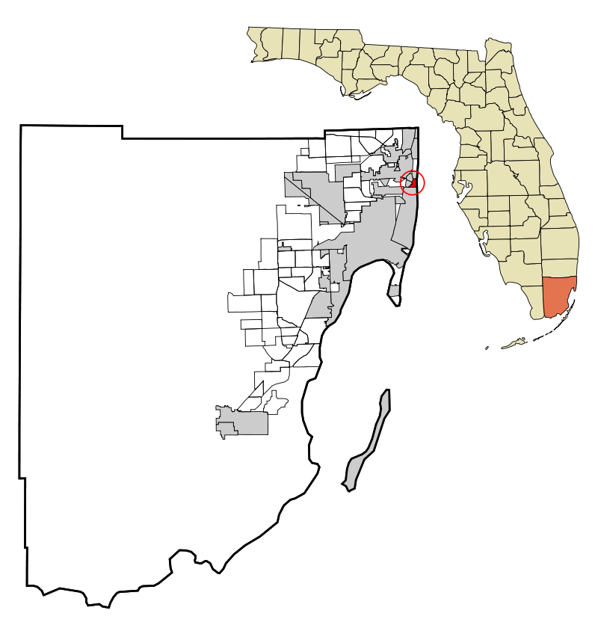
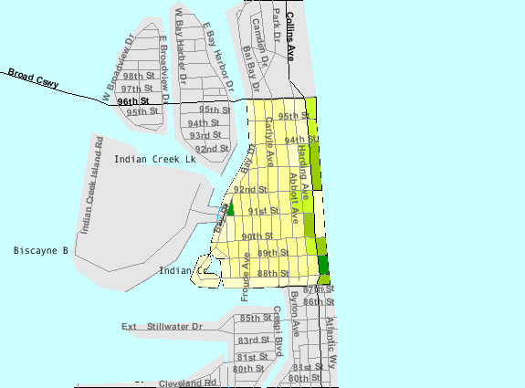
Surfside – Geography
Source: https://en.wikipedia.org/wiki/Surfside,_Florida

Slide 4
Surfside – Facts and Figures
0.5 square mile of land
Coastal ridge
Average elevation – 6 feet
Highest elevation - 12 feet
~5,700 residents
Water/sewer service provide by Miami-Dade County
Pump stations, pipes and stormwater system owned and operated by the Town

Slide 5
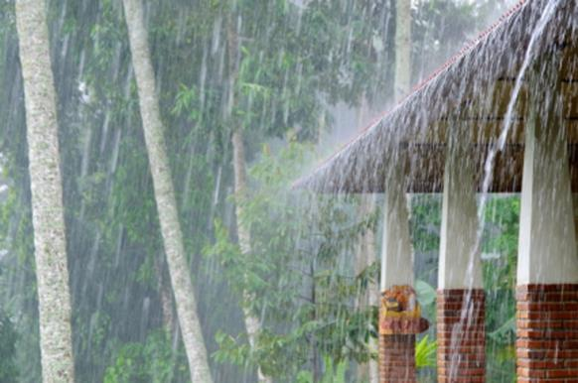
Water Disaster Hazards
Precipitation
Sea Level Rise
Storm Surge

Slide 6
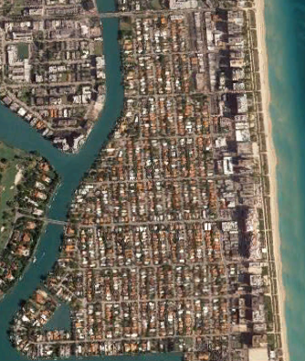
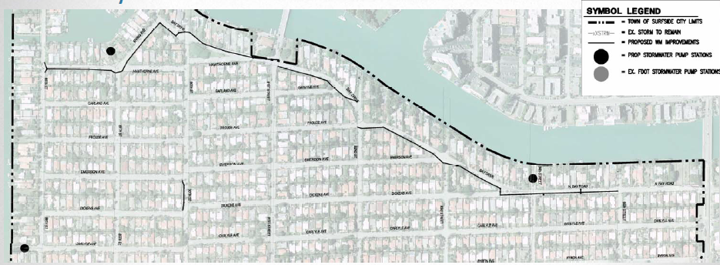
Precipitation
Average rainfall
50” to 60” annually
High intensity, short duration rain events
Built environment restricts percolation
Adequacy of stormwater system
Source: Google Earth
Source: Town of Surfside

Slide 7
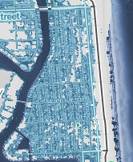
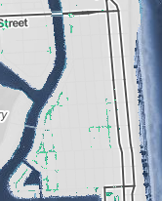
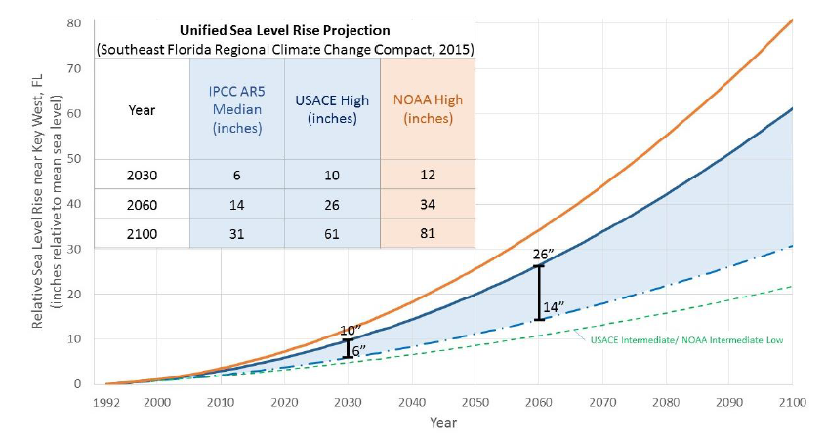
Sea Level Rise
Education is critically important
Consider actions in the short, intermediate and long-term
Orderly relocation
Source: http://www.southeastfloridaclimatecompact.org/wp-content/uploads/2015/10/2015-Compact-Unified-Sea-Level-Rise-Projection.pdf
4 Feet
2 Feet
Source: Climate Central

Slide 8
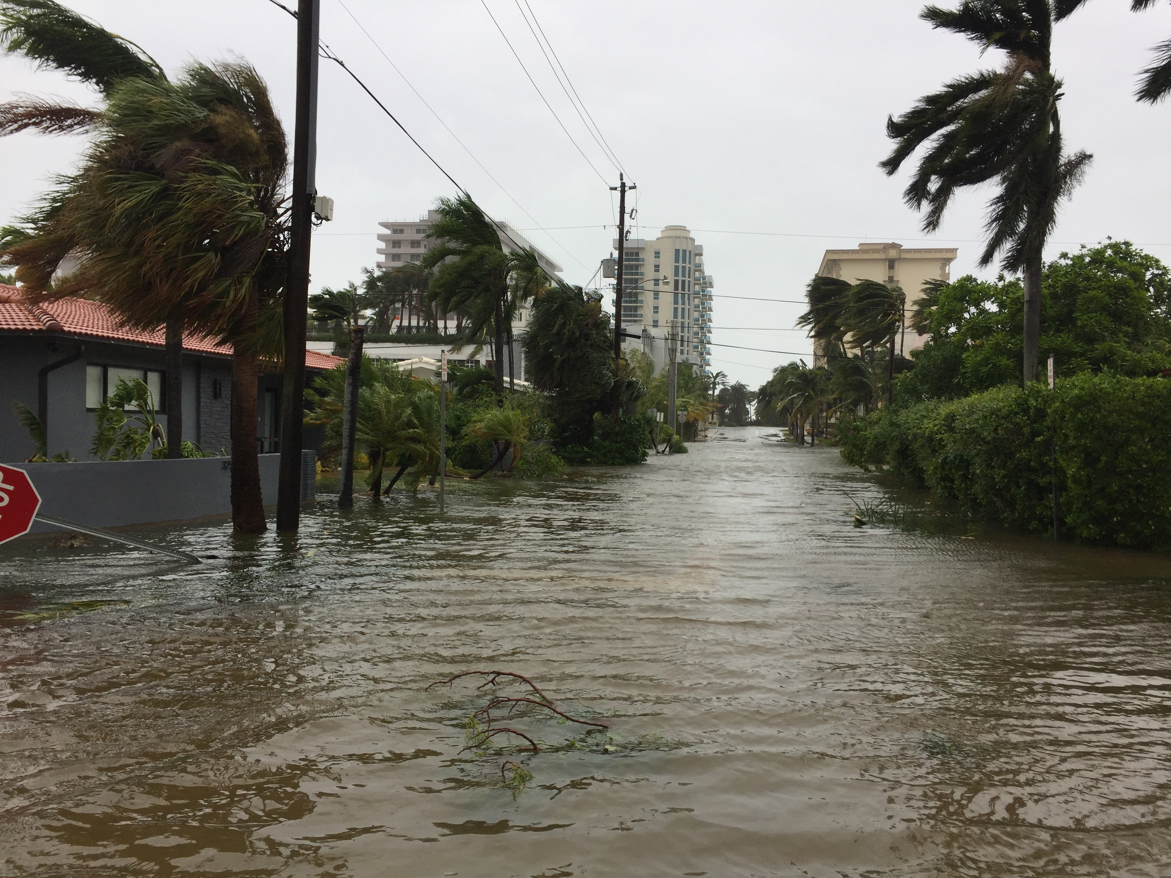
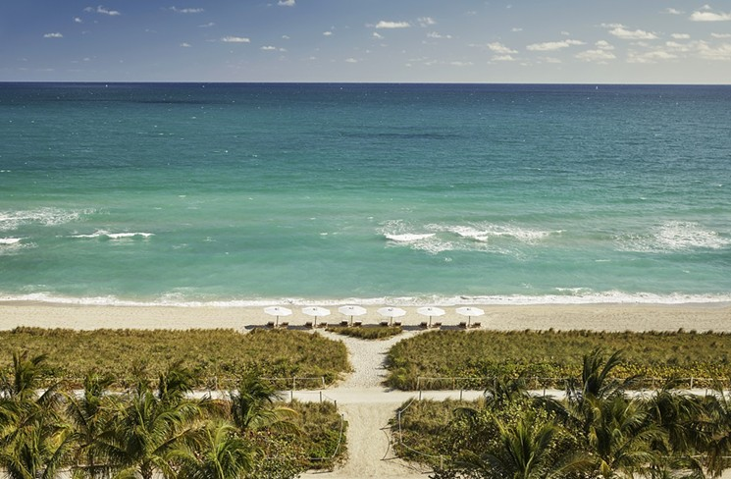
Storm Surge
Raise risk awareness
Dunes and sea walls are the front lines
Harden essential infrastructure
Source: Town of Surfside
Source: Miami New Times

Slide 9
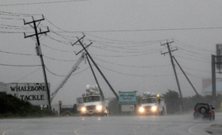
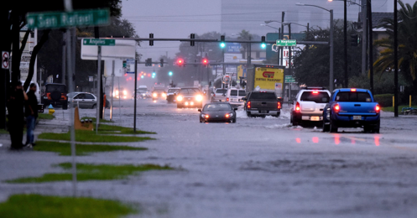
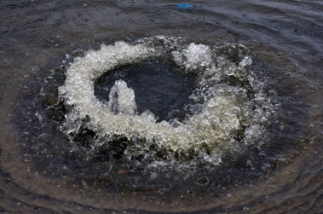
Statewide Challenges
Population has doubled in last 30 years and set to do so again in next 25 years, increasing by nearly 1,000 people per day
Most population centers are located along the coast, vulnerable to coastal flooding
Coastal areas are experiencing saltwater intrusion, affecting local water supply
Geographic disparity between supplies and demands

Slide 10
Political Considerations
Multiple priorities
Balance growth with known hazards
Don’t be afraid of the science
Short-term thinking conflict with long-term solutions
Election timing matters
Seek out municipal and NGO partners
Provide hope not despair

Slide 11
Thank You
Daniel Dietch
Town of Surfside
(305) 861-4863
ddietch@townofsurfsidefl.gov

