Slide 1
Florida League of Cities 6th Annual Fall Research Symposium Ready & Resilient: Combating Water Hazards in an Era of Extreme Weather
A Future of Resilient Infrastructure
Jerry Murphy, JD, AICP, CFM
Research + Development Manager
University of Florida Resilient Communities Initiative
Notes:
Good Morning:
I’m Jerry Murphy with the University of Florida Resilient Communities Initiative.
I and my 100 slides are what stand between you and lunch. I’ll be quick.
I’m a legal scholar, certified planner, and certified floodplain manager.

Slide 2
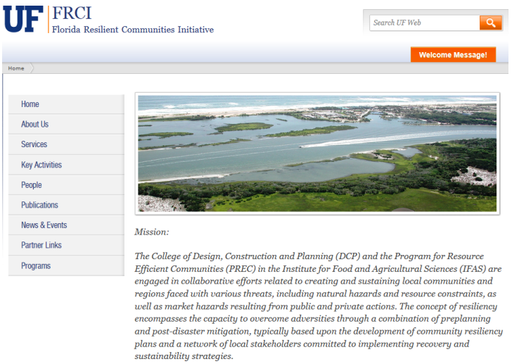
UNIVERSITY OF FLORIDA RESILIENT COMMUNITIES INITIATIVE (UFRCI)
Website: http://frci.dcp.ufl.edu/
Notes:
I’m the Research + Development Manager for the University of Florida’s Resilient Communities Initiative.
Here’s a screen shot of the home page of our website and the address.

Slide 3
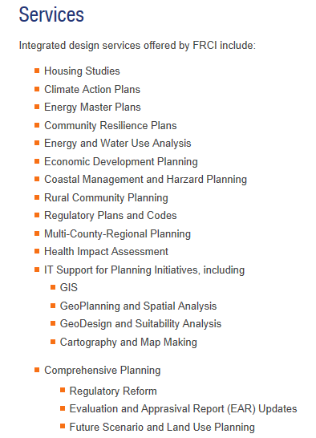
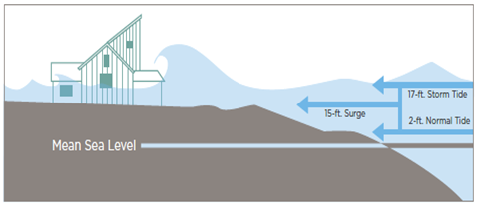
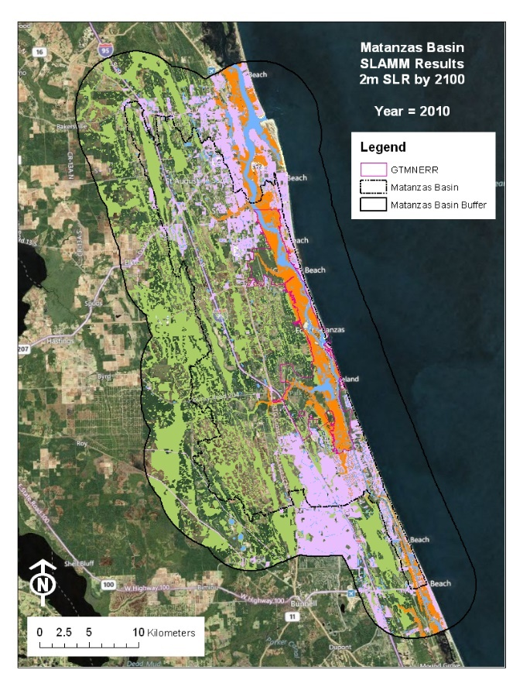
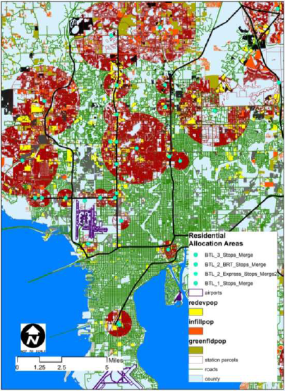
UNIVERSITY OF FLORIDA RESILIENT COMMUNITIES INITIATIVE (UFRCI)
Source: Center for Coastal Resource Mngt.
Source: Anna Linhoss, Greg Kiker
Source: Bus Toll Lane Proof-of-Concept Study
Website: http://frci.dcp.ufl.edu/
Notes:
There is nothing our faculty, staff, and students can do TO a local government.
There is much we may be able to do FOR you.

Slide 4
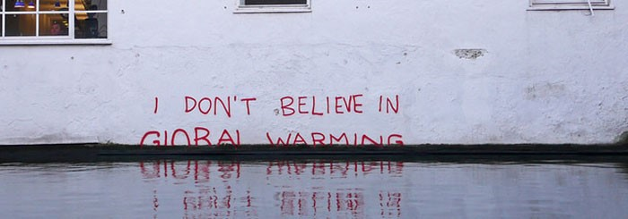
A Future of Resilient Infrastructure
Notes:
One of the first steps toward a future of resilient infrastructure is an acceptance of current and future global conditions.
Global warming, climate change, Sea Level Rise (SLR)—call it what you will, blame or no blame—the important policy decision is to recognize flooding is more frequent, more persistent, and we are in the rising water level part of any scenario where these more persistent flood waters may recede.
In biblical literature, God gave a warning, direction, and Noah built an Arc. Is there some irony that the primary US Gov’tal agency dealing with the measurement and dissemination of clmate data in this regard is NOAA?

Slide 5
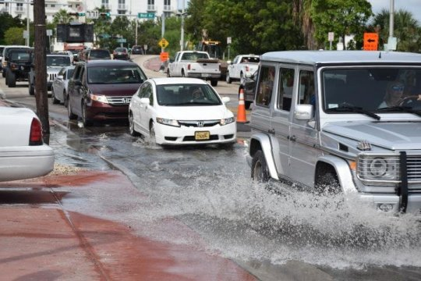
A Future of Resilient Infrastructure
SEA-LEVEL RISE: SLR
Notes:
For purposes of our discussion today, I’ll try to stick with SLR.
This is increasingly anywhere in coastal Florida. And not just during a hurricane or tropical storm.

Slide 6
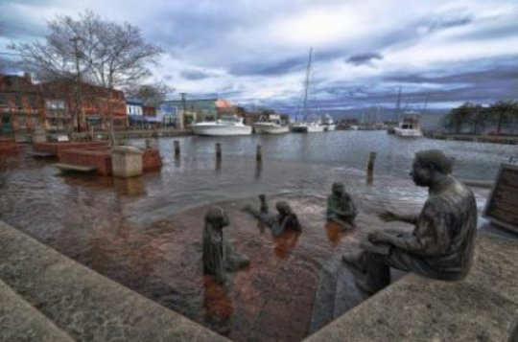
A Future of Resilient Infrastructure
SEA-LEVEL RISE: SLR
NUISANCE FLOODING
Notes:
This is the monument to Alex Haley—author of the Roots saga—in Annapolis, MD, during a nuisance event.

Slide 7
A Future of Resilient Infrastructure
Notes:
Here it is after beach renourishment.
No.
This is snow. Who here knows what snow is?
It’s been a once in a decade or less type of event in Florida – Peninsular Florida, anyway – in my five (5) decades in the state.
What does the future hold? Snow, I’ll remind the more Floridian of y’all is just another form of water, of precipitation

Slide 8
Notes:
Here’s a picture of the conditions the monument’s designer envisioned.

Slide 9
A Future of Resilient Infrastructure
Notes:
But things can always get worse. . . and we are in the rising water level part of any scenario where the flood waters ultimately recede. When extreme events become more frequent, they are no longer extreme. They are the (otherwise beloved) status quo.

Slide 10
A Future of Resilient Infrastructure
Every coastal and low-lying Florida community—and coastal and low-lying areas everywhere on Earth—are increasingly going to be affected by sea-level rise (SLR).
Notes:
One of our major municipal challenges is to plan for more resilient infrastructure. So I challenge you—in the 21st Century—to rethink and even broaden your sense and understanding of the term infrastructure.

Slide 11
A Future of Resilient Infrastructure
0.25 – 6.67 feet in the next
15 to 85 years.
Notes:
The predictions for SLR vary—and seem to only be increasing with each new study—but I encourage you to focus on the R. I’m aware of no scenario that does not predict a rising sea level.

Slide 12
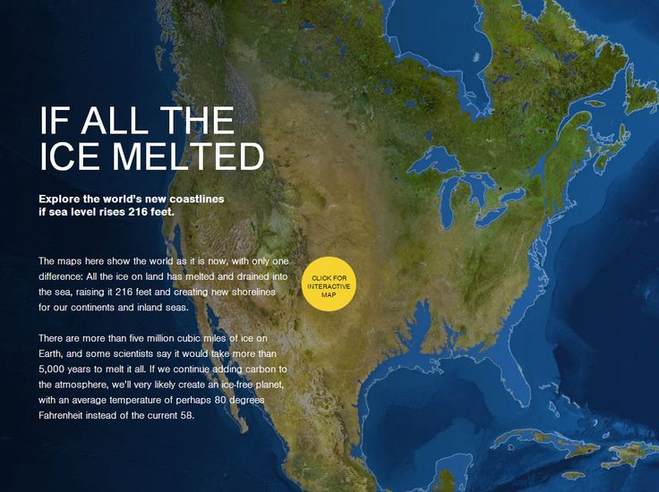
A Future of Resilient Infrastructure
Notes:
So, who here is from the “heartland” of Florida?
I often say that some day, I will move to the Bok Tower in Lake Wales, if I live so long. It’s my somewhat pessimistic promo for Polk County.
I fear it will someday be like a Road Warrior movie to get there. And then for how long?
This slide goes to the argument that we need to stop the sources of [whatever you want to call it] [Audio note: CSN(Y) LIVE ALBUM—”Whatever you want to call it]

Slide 13
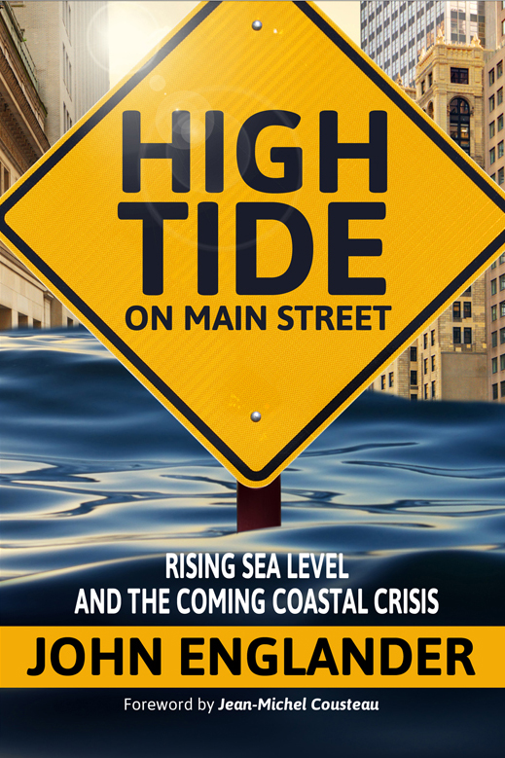
A Future of Resilient Infrastructure
Introduction to the SLR issue:
Ice melts above 32 degrees, no matter what your political party. Ice melts; water rises; shorelines retreat.
Notes:
John Englander; who here have had a chance to encounter Dr. Englander?
I commend to you his very accessible text, High Tide on Main Street, if you haven’t already.

Slide 14
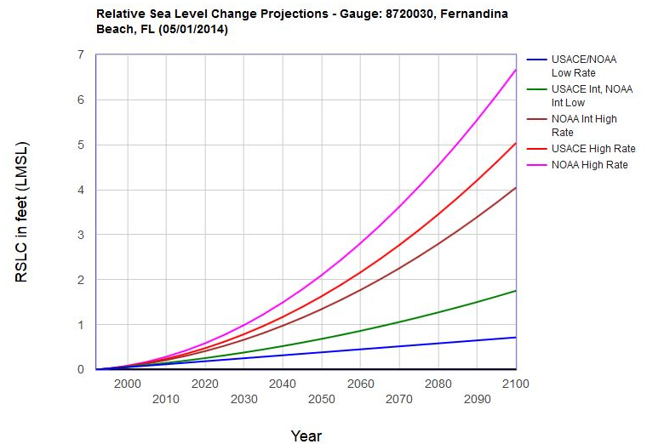
A Future of Resilient Infrastructure
SEA-LEVEL RISE: SLR
“SANDY”
NUISANCE FLOODING
Examination of SLR Trends and Projections
Notes:
Here’s a graph of the various trends and projections for sea-level rise.

Slide 15
A Future of Resilient Infrastructure
How cities prepare to address the impacts of this eventual inevitability is paramount to their resilient future.
Notes:
For these reasons, we call this an “eventual inevitability.” Like the proverbial frog in the pot of cold water place on the stove on simmer, it is so eventual, that it’s hard to feel it coming. But the signs in coastal Florida are almost everywhere.

Slide 16
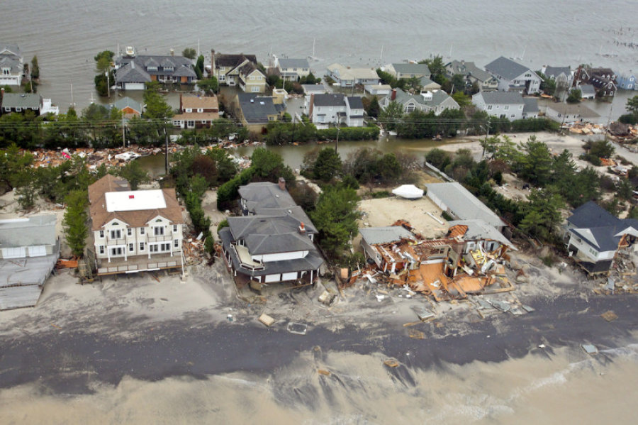
A Future of Resilient Infrastructure
SEA-LEVEL RISE: SLR
“SANDY”
NUISANCE FLOODING
Notes:
Witness the aftermath of “superstorm” Sandy that effected the majority of the east coast of the US

Slide 17
A Future of Resilient Infrastructure
Mapping the Local Impacts these projections indicate are facing St. Augustine, given the City’s geographic context.
Notes:
One of our early UFRCI projects was a SLR study for the City of St. Augustine.

Slide 18
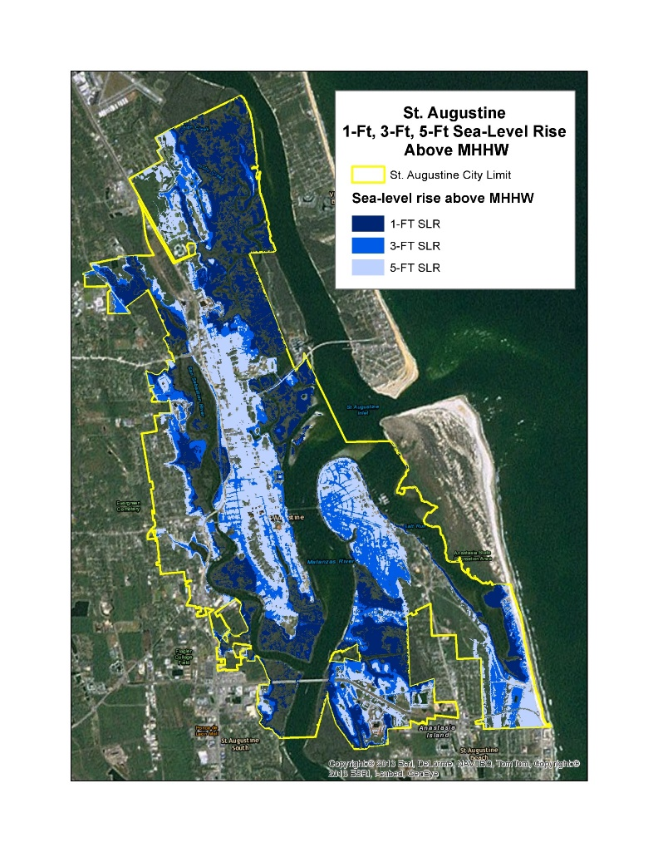
Adapting to Rising Tides Coastal Resilience in St. Augustine: Baseline of Our Past, Beacon for Our Future
Notes:
Looking at scenarios for the longest continuously occupied city in the US with low, medium, and higher range scenarios for SLR and where inundation would occur within the City.

Slide 19
Adapting to Rising Tides Coastal Resilience in St. Augustine: Baseline of Our Past, Beacon for Our Future
Concludes with Next Steps: Community Adaptation Strategies and Tools for the City to consider for the near- and longer-term future.
Notes:
That study report helped the City identify where infrastructure, e.g., sanitary sewer lift stations, would be effected by SLR under the various scenarios for rise.

Slide 20
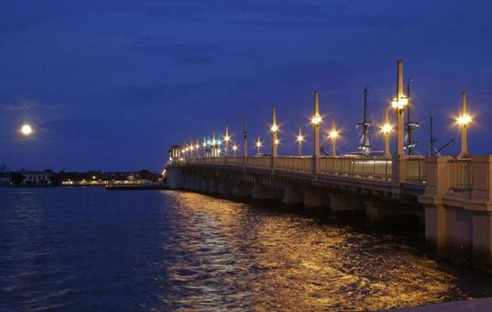
Adapting to Rising Tides Coastal Resilience in St. Augustine: Baseline of Our Past, Beacon for Our Future
First Steps:
Capital Improvements Element and CIP
Intergovernmental Collaboration, Cooperation, and Coordination
Potential Impacts, Strategies & Next Steps
Next Steps
Notes:
One of the next steps for the City of St. Augustine: Utilized the SLR scenarios map to identify vulnerable sanitary sewer lift stations for elevation, generator back-up, and potential relocation.

Slide 21
ReCharting Longboat Key:
Toward Community, Economy, and Resiliency
Urban and architectural design studio in support of revising comprehensive planning regulations for the Town of Longboat Key Florida.
prepared by
University of Florida Resilient Communities Initiative
College of Design Construction and Planning
Notes:
In anticipation of a complete comprehensive plan overhaul (in light of the 2011 Community Planning Act), we focused an urban design studio on long-range future planning for the Town of Longboat Key.

Slide 22
The Challenge
To move Longboat Key forward through a synthesis of existing investment, resiliency, nature, growth, employment, and lifestyles that respect and enhance this world class destination.

Slide 23
Process
Analysis
Diagnostic Elements
Master Plan Components
Locations of Opportunity
Anticipated Futures

Slide 24
Analysis
Research includes geography of the region, regional development typologies, local development, and environmental projections for the region and Longboat Key.
Florida West Coast
Typological Morphology - Residential
Sea Level Rise - Projected
Land-Use Map
ULI and UDS Summary of Context
Longboat Key by Air

Slide 25
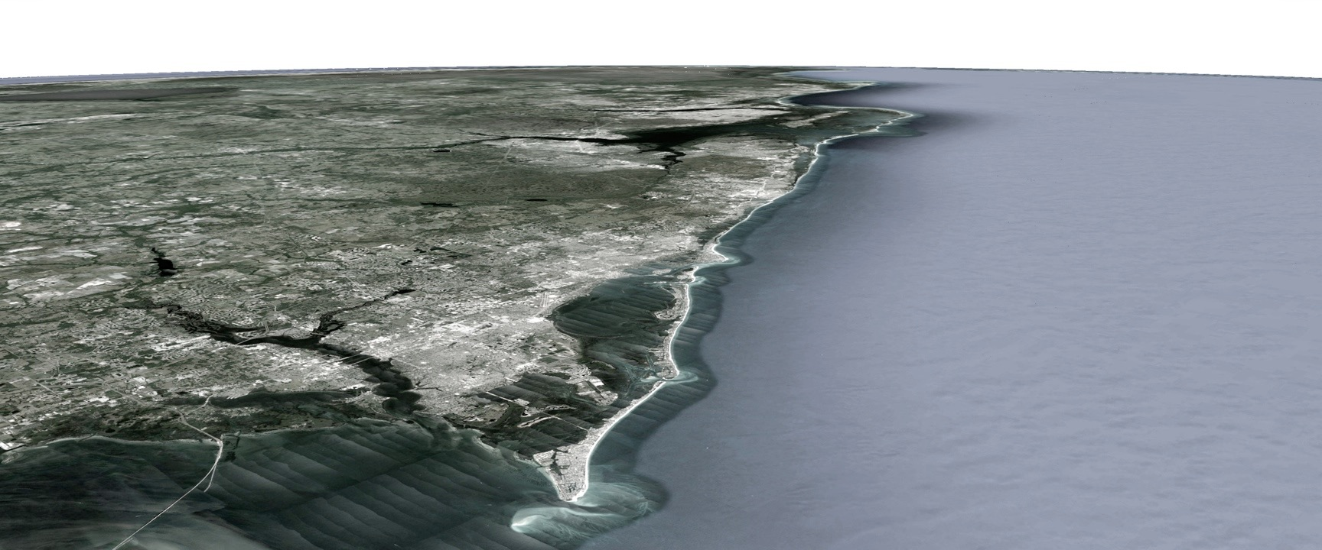
Florida West Coast

Slide 26
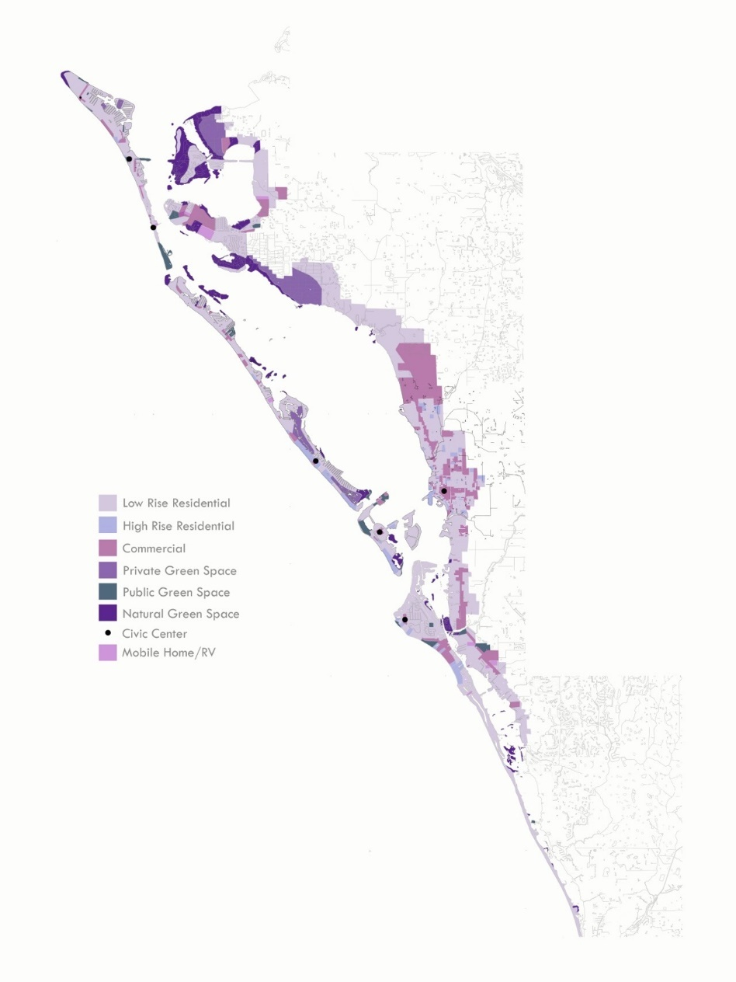
Anna Maria to Casey Key

Slide 27
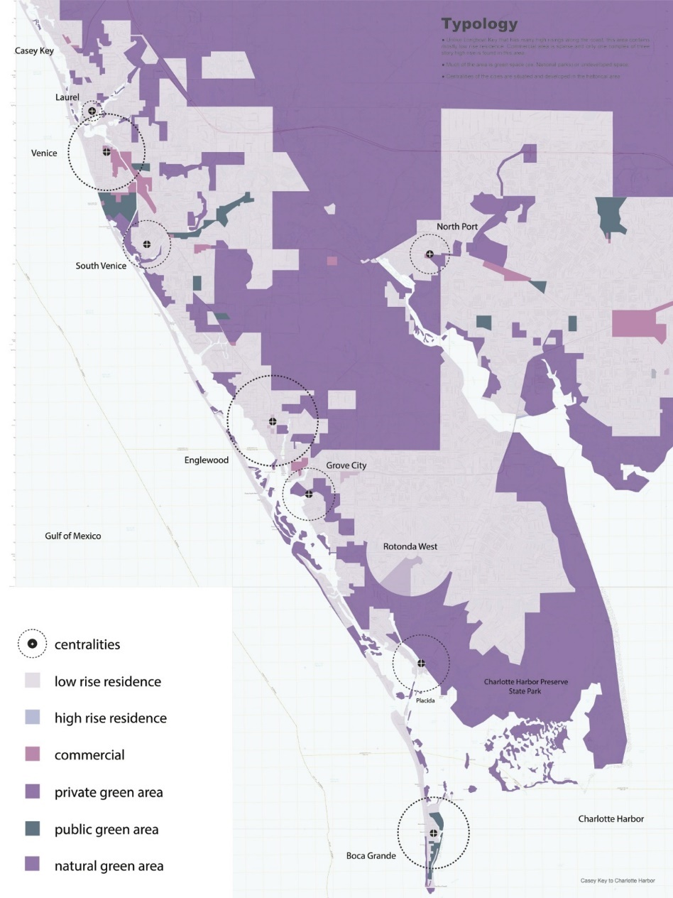
Casey Key to
Charlotte Harbor

Slide 28
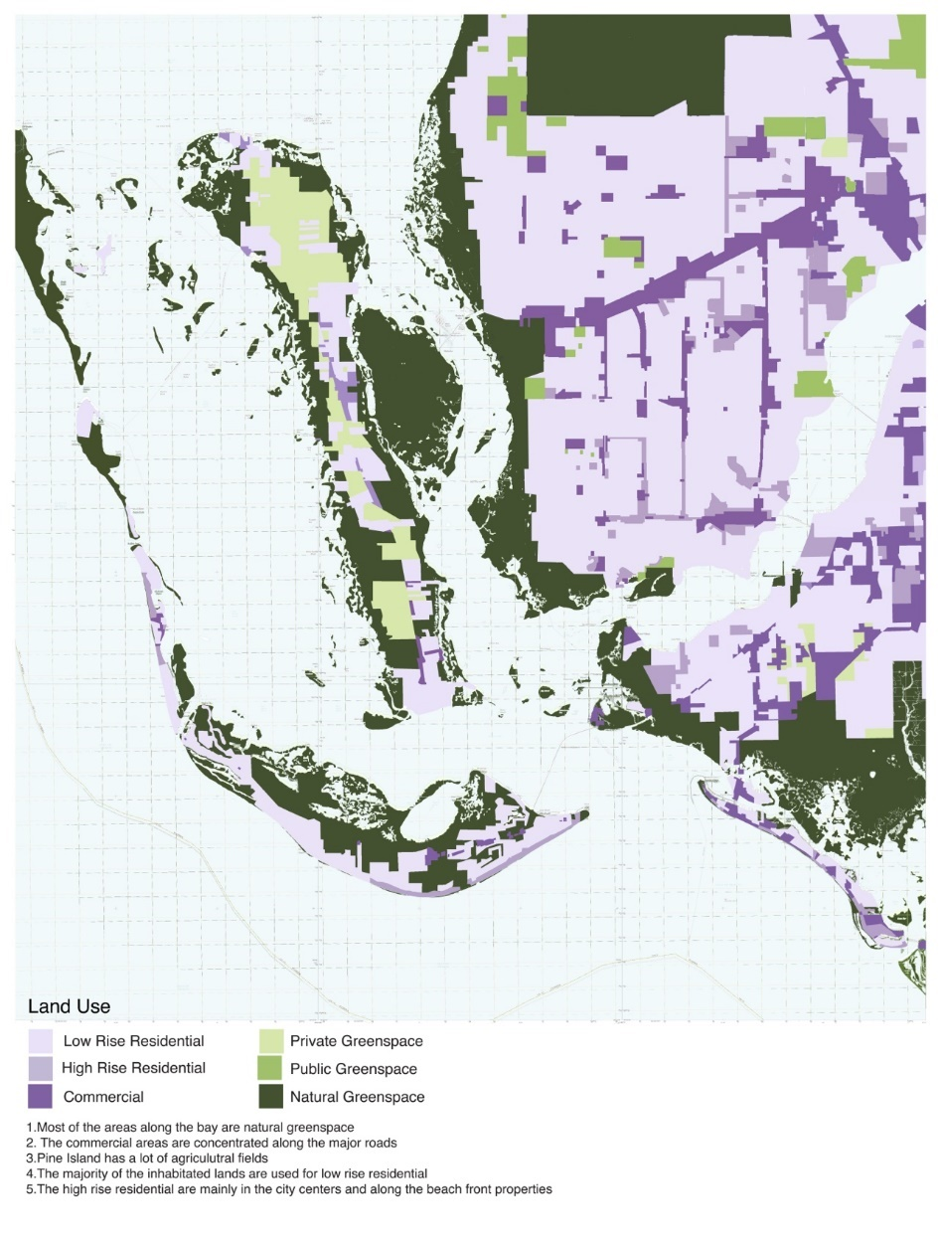
Charlotte Harbor to Sanibel

Slide 29
Typological Morphology - Residential

Slide 30
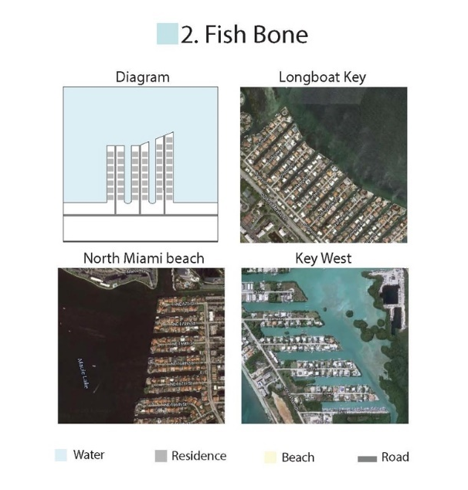
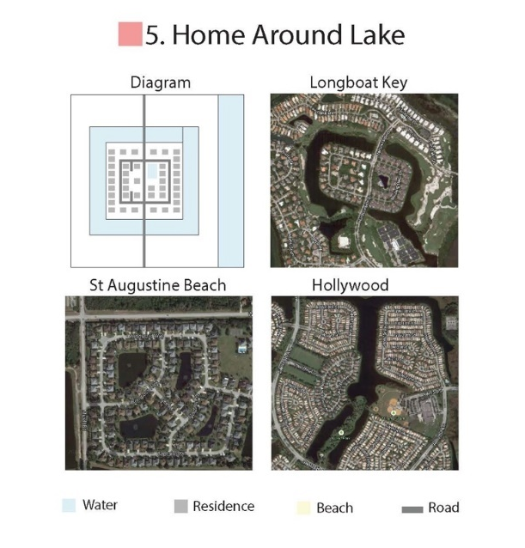

Slide 31
Sea Level Rise - Projected

Slide 32
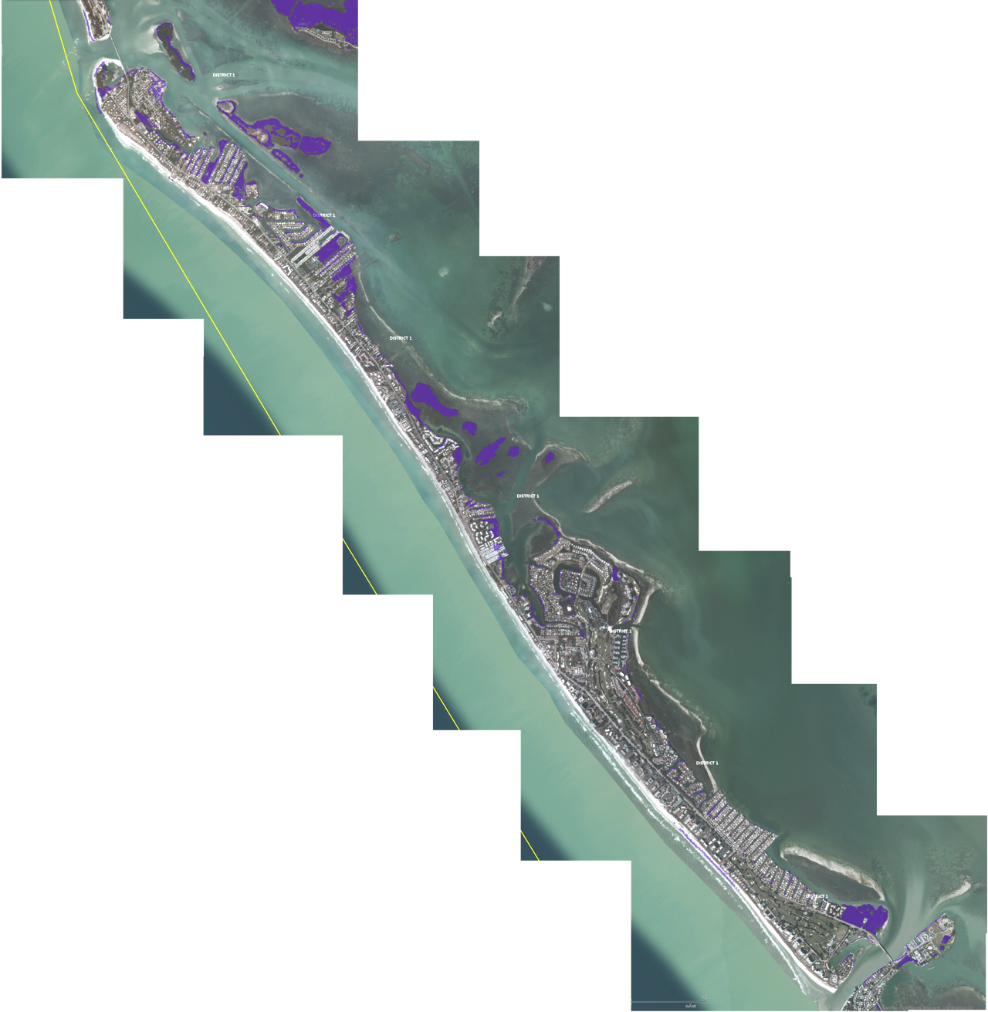
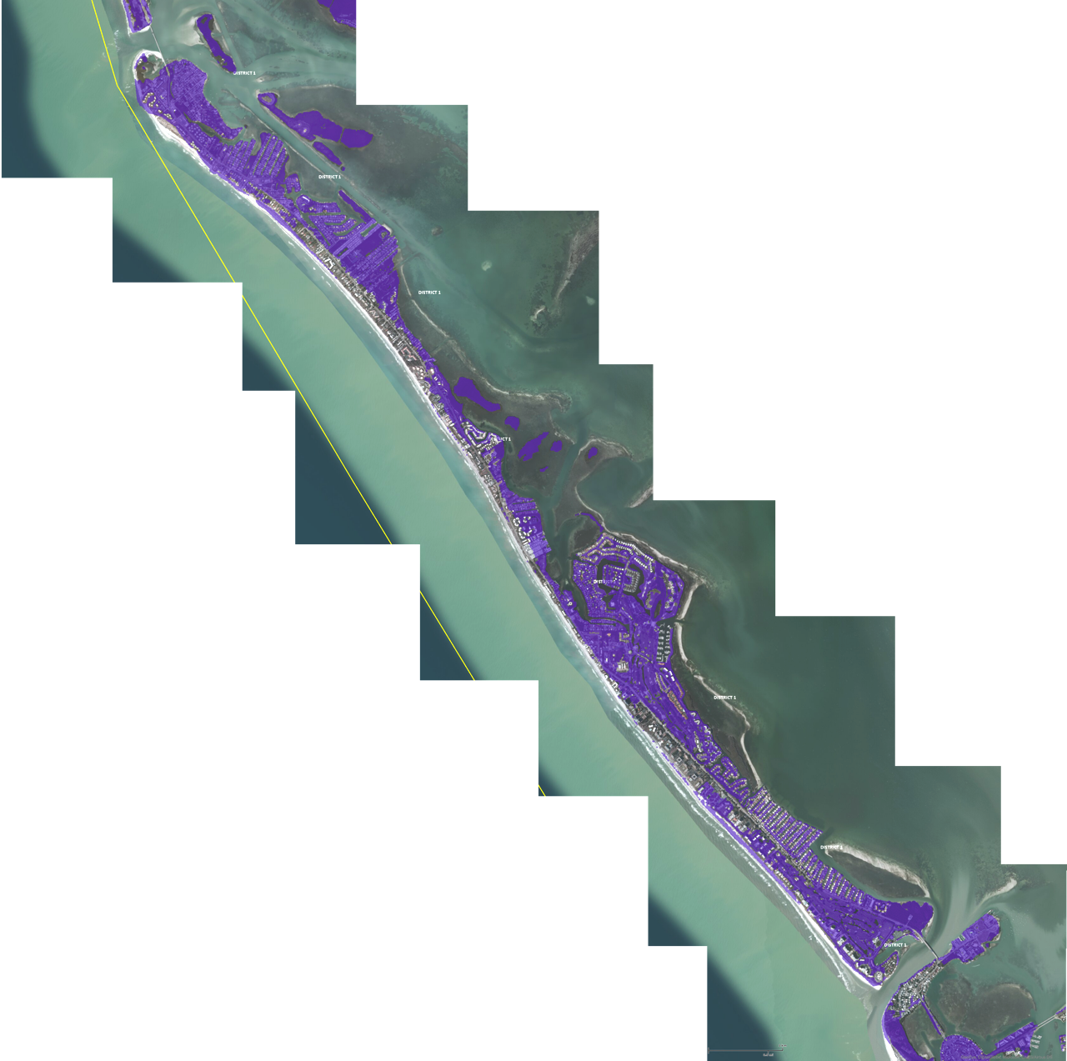
Sea Level Rise Projected
"Sea levels
at Longboat Key are likely
to increase
at least
3 feet.
By 2050, and
could increase
as much as
5 feet or higher
as early as
2035
according to
recent measurements
and glacial melting observations."
5 foot rise
high estimate
year 2100
3 foot rise
median estimate
year 2100
UF Geoplan, Army
Corp of Engineers and NOAA
Notes:
St. Augustine may as well be a barrier island on the east coast—much more oceanic-ally active—than Longboat Key. LBK is actually a barrier island and has no defenses from SLR or storm surge.

Slide 33
Current Land Use

Slide 34
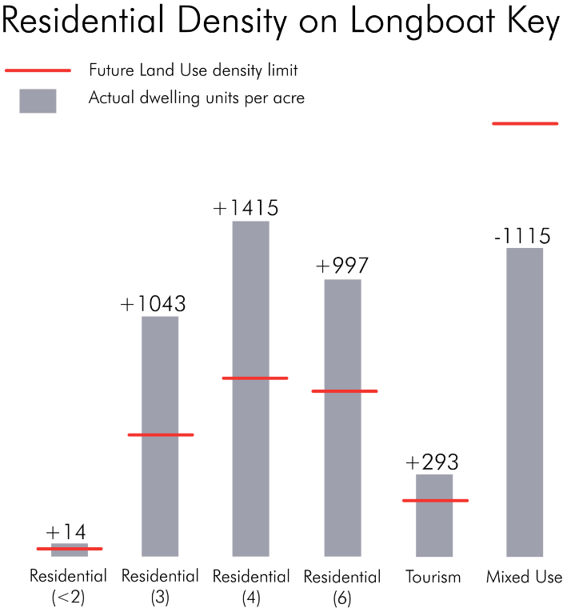
Land Use Designations

Slide 35
ULI and UDS summary of context
1. Longboat Key is a richly diverse coastal ecology that combines beach, bay, and estuary habitats along a narrow strip of land allowing almost all residents access to water and the natural beauty of the coastal habitat. This character is threatened by sea level rise in the long-term (50 to 100 years) and by beach erosion and storms in the near term through the loss of developed property and economic activity.
2. Longboat Key is a internationally recognized retirement destination offering an overall community composed of a collection of traditional residential neighborhoods, planned developments, compact housing, and condominiums with separate social networks. Particular areas are ready for redevelopment due to aging building stock, contemporary cultural expectations, increasingly stringent building code requirements, market demands for housing amenities, and market opportunities for commerce diversity.
3. Longboat Key is a tourist destination with a diverse collection of luxury resorts, time-share condominiums, and affordable hotels. Some redevelopment of tourist infrastructure is needed and should be considered with regard to density, market demands, building form, existing investment, longevity, and environmental forces.
4. Longboat Key has a rich heritage as a tennis and golf resort community with other recreational activities on the rise including cycling, boating, kayaking, and nature hiking. These types of fitness oriented recreation activities are generally expanding culturally and should guide planning decisions and community design toward enhancing the quality of these experiences.
5. Longboat Key is dynamic in terms of both the coastal geography and the native resident population subsequently requiring appropriate policies with overlapping planning trajectories – 5, 10, 25, 50, and 100 year horizons – coupled with an adaptive management structure to make necessary realignments on an appropriate schedule.

Slide 36
Diagnostic Elements
Strengths
Environmental Assets: preserved ecotones - beach/dune/ocean - mangrove/marsh/bay
Development: existing compact living / well-established neighborhoods / sports infrastructure (parks, boating, golf, tennis, kayaking) / historic community / established commercial districts/
Weaknesses
Infrastructure: mobility/utilities/beach erosion
Identity: ambiguous

Slide 37
Diagnostic Elements
Opportunities
Consensus on the need for planning changes - revise land use code
strategic response to environmental threats
Steering development toward community goals
Developing identities/places within the Key
Weaknesses
Infrastructure: mobility/utilities
Identity - ambiguous

Slide 38
Diagnostic Elements
Opportunities
Consensus on the need for planning changes - revise land use code
strategic response to environmental threats
Steering development toward community goals
Developing identities/places within the Key
Threats
Risk Factors - ecological: hurricane and storm surge / erosion / sea level rise
Obsolescence - early tourist developments / connectivity / civic elements / planning ordinances

Slide 39
Locations of Opportunity
1. Gulf of Mexico Drive
2. Longbeach Village
3. Whitney Plaza and Ringling Arts Center
4. Harry’s and St. Jude Street
5. Centre Shops and Durante Park
6. Hilton Hotel Site
7. Bayfront Park
8. Manufactured Home Village
9. The Beach Hotel
10. The Diplomat
11. Downtown
12. The Colony
13. South Key Threshold

Slide 40
Anticipated Futures

Slide 41
Guiding Principles
Enhance and protect natural assets
Build distinctive identity markers
Gulf to Bay connections - weaving
New linkages to mainland
Enhancing centralities at selected locations
Resilient settlement typologies
Sea level rise responses
Innovation in destination diversity
Enhancing Gulf of Mexico Drive with layered mobility
Expanding employment opportunities
Diverse residential options
Develop appropriate renewable energy incentives
Enhance resilience of municipal infrastructure
Building community consensus
Promote schematic visioning toward vetting development
Notes:
So: In law and in planning, we have to abide by certain inalienable principles—said in the context of a dynamically evolving democracy: health, morals, safety, welfare, i.e., the police powers

Slide 42
Master Plan Concepts - parametric analysis
Layered Mobilities - Gulf of Mexico Drive as multi-modal civic greenway
Connections and Centralities - Directly linked to the mainland with mobility independence and nodal identity.
Modified Ecologies - enhancing access to nature amenities and human encounters with ecologically responsive development.
Cross-connecting Places - Gulf to Bay linkages through vibrant activity centers
Longboat Key 2101 - Strategic priorities for a Longboat Key Masterplan

Slide 43
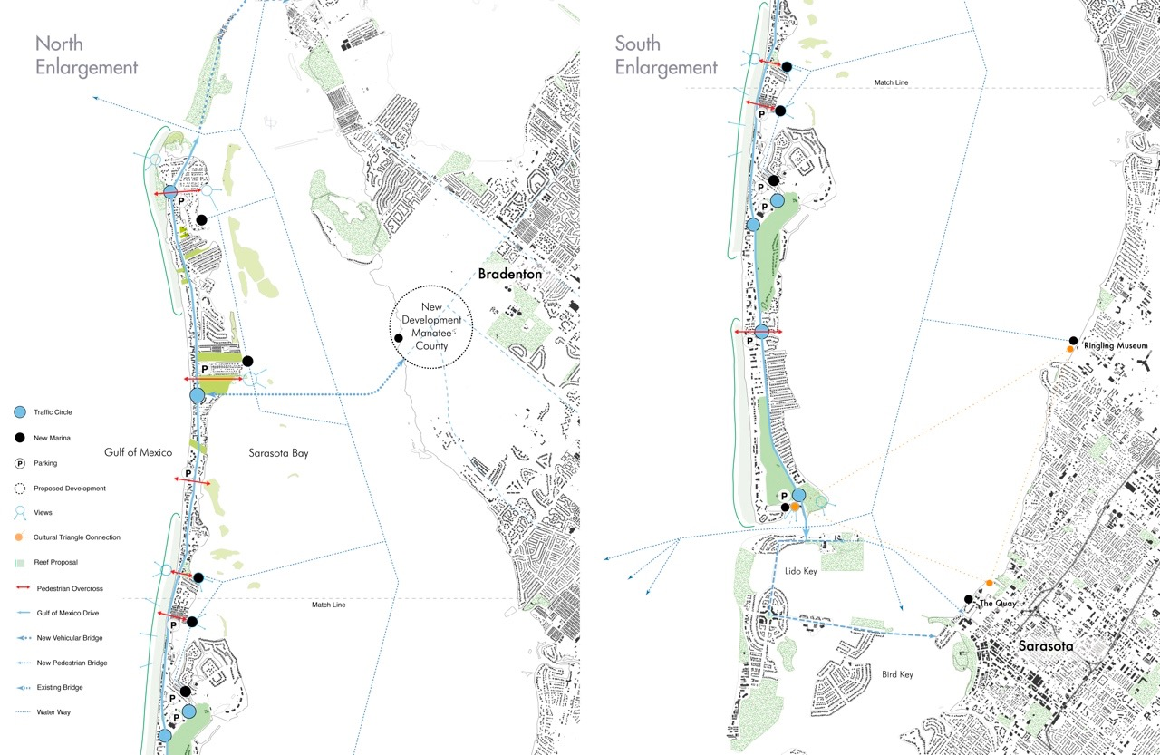
LBK 2101

Slide 44
Conceptual Design Proposals
(north to south)
.
Long Beach | Jesse Mantohak | Amphi-Bio City: Foreseeing Longterm Development in the Historic Fabric
 | Silvia Aloisio | Resiliency Through Floating: Permanence of Historic Grid
Whitney Beach | Alexandria Schmidt | Commerce, Living, and Civic Event on the Lawn
 | Shane LaMay | Commerce, Living, and Civic Event on the Canal
Harry’s & St Jude’s Drive | Silvia Aloisio | Recombinant canal living
Center Shops | India Brooks | Civic Marina Resort: Cross Island Pedestrian Experience
Twin Shores | Di Hu | Resilient Podium Community: Density and View-Integrated Complex
Hilton Longboat Key | Matthew Kaminsky | Folding Destinations: Sunset Views
Bayfront Park | Alexander Thomas | Modified Confluence: Recreation and Civic Node
Downtown Interventions | Lily Hung | Healthcare Resort and Civic Plaza
 | Silvia Aloisio | Water Scape and Urban Canal
Colony | Emily Porter | Resilient Resort: Flood Resilience
 | Lauren Day | National Tennis Training Resort and Stadium
 | Craig Nightingale | Reef Resort: Reconstructing the Beach
South Key Threshold | Xuancheng Zhu | LoKeMOMA - Longboat Key Museum of Modern Art
 | Jessica Phillips | Aquaponica: Aquarium + Hydroponics

Slide 45
Longbeach

Slide 46
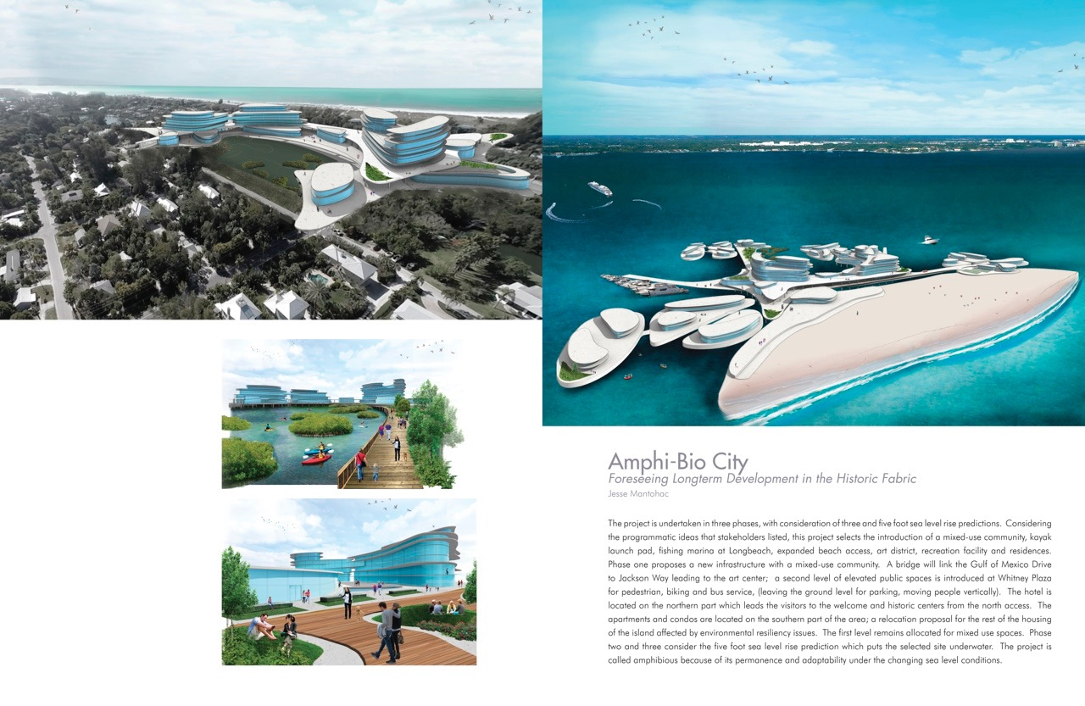

Slide 47
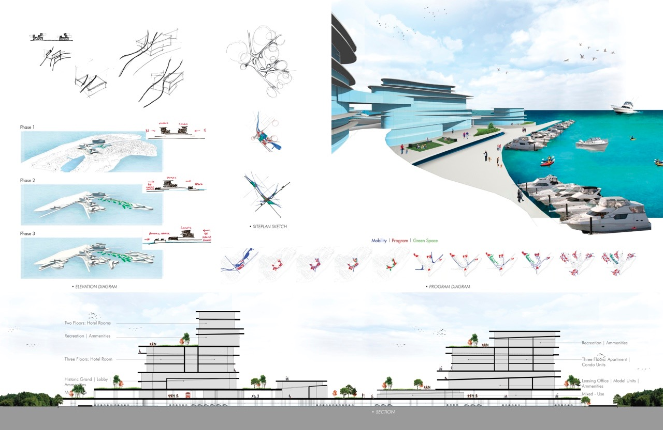

Slide 48
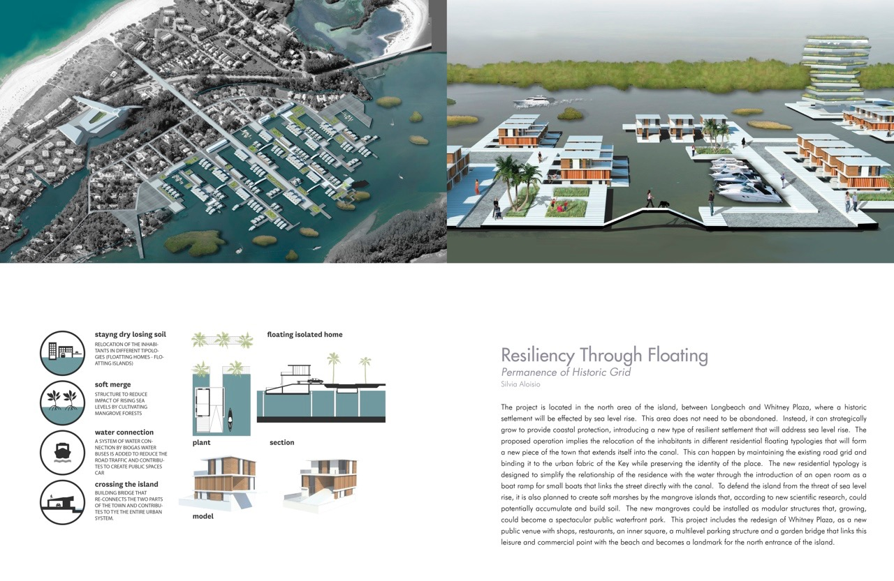

Slide 49
Whitney Plaza

Slide 50
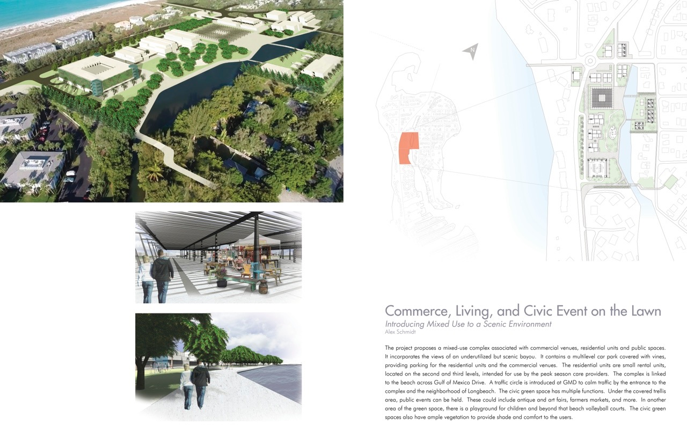

Slide 51
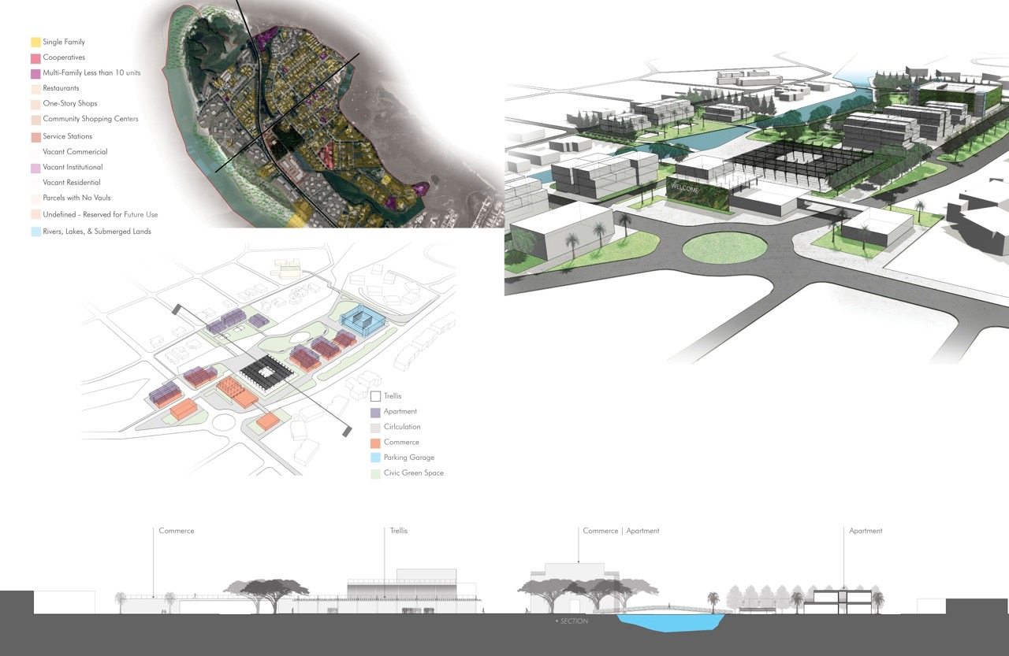

Slide 52
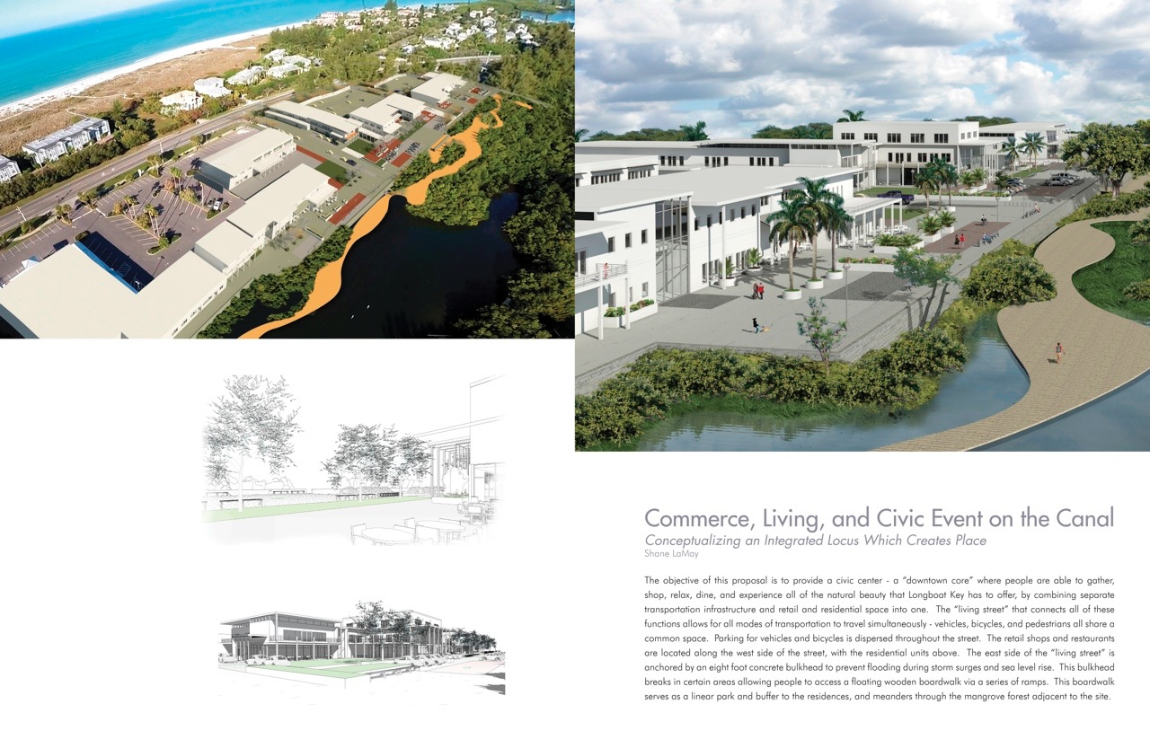

Slide 53
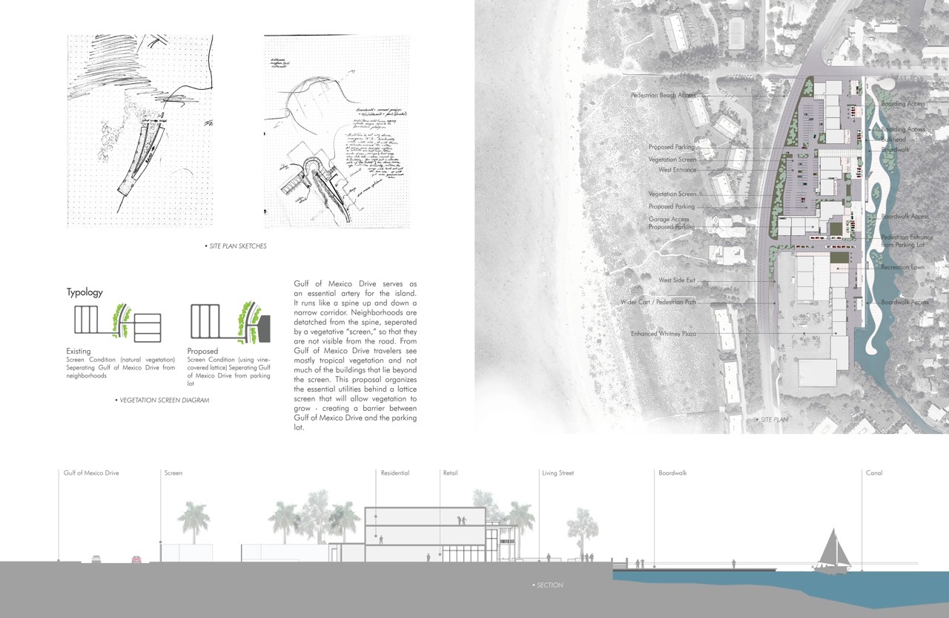

Slide 54
Harry’s and St. Jude’s Drive

Slide 56
Centre Shops

Slide 57
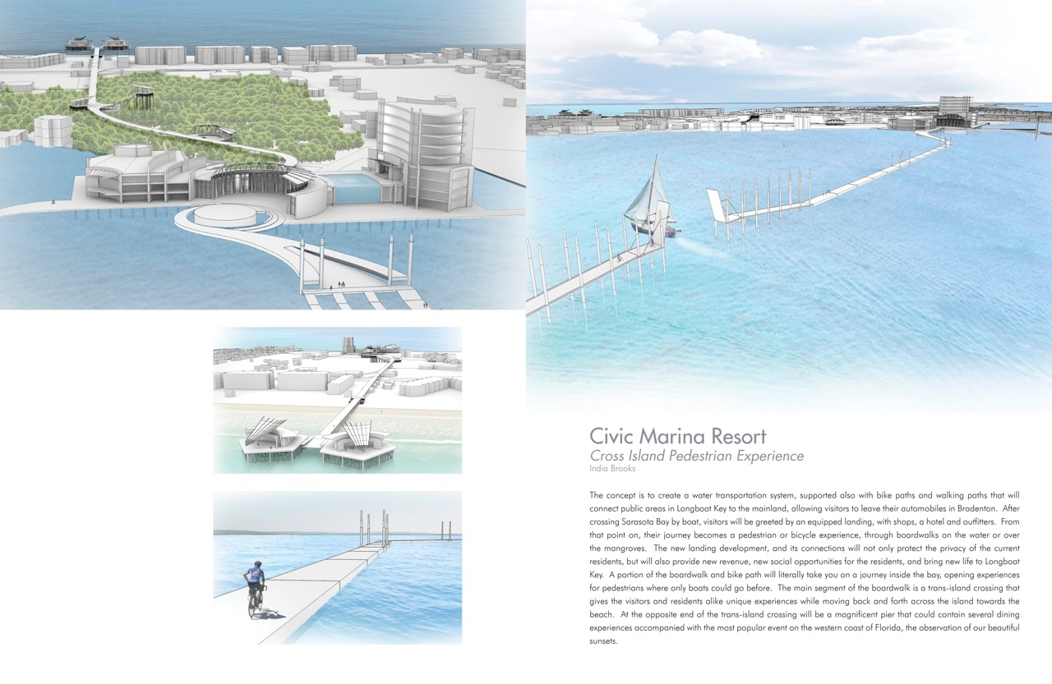

Slide 58
Twin Shores

Slide 59
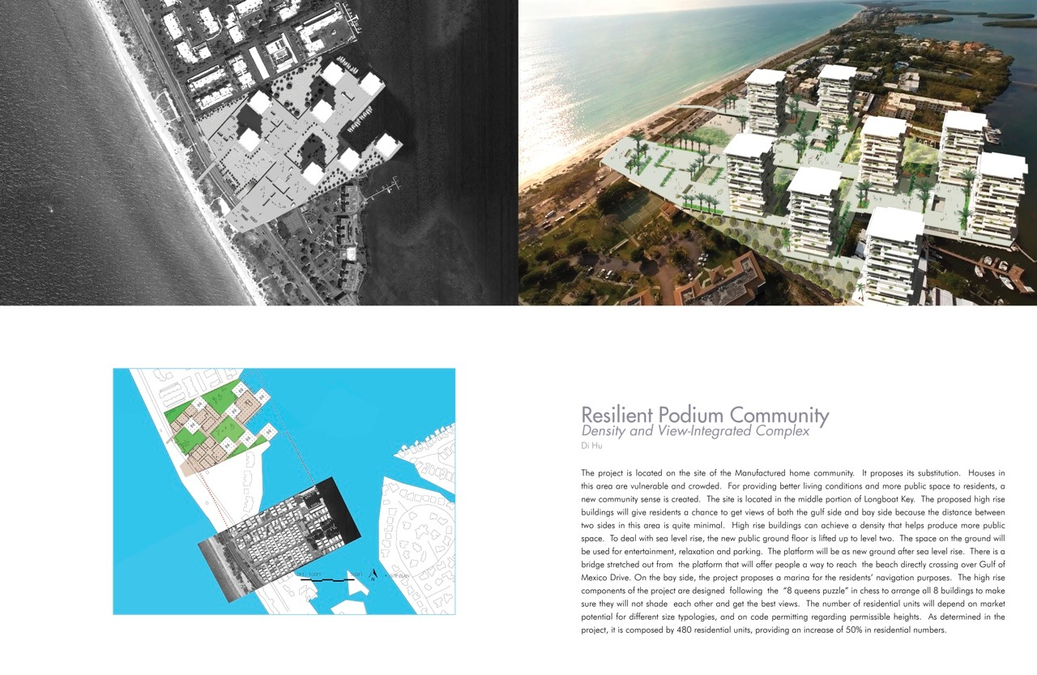

Slide 60
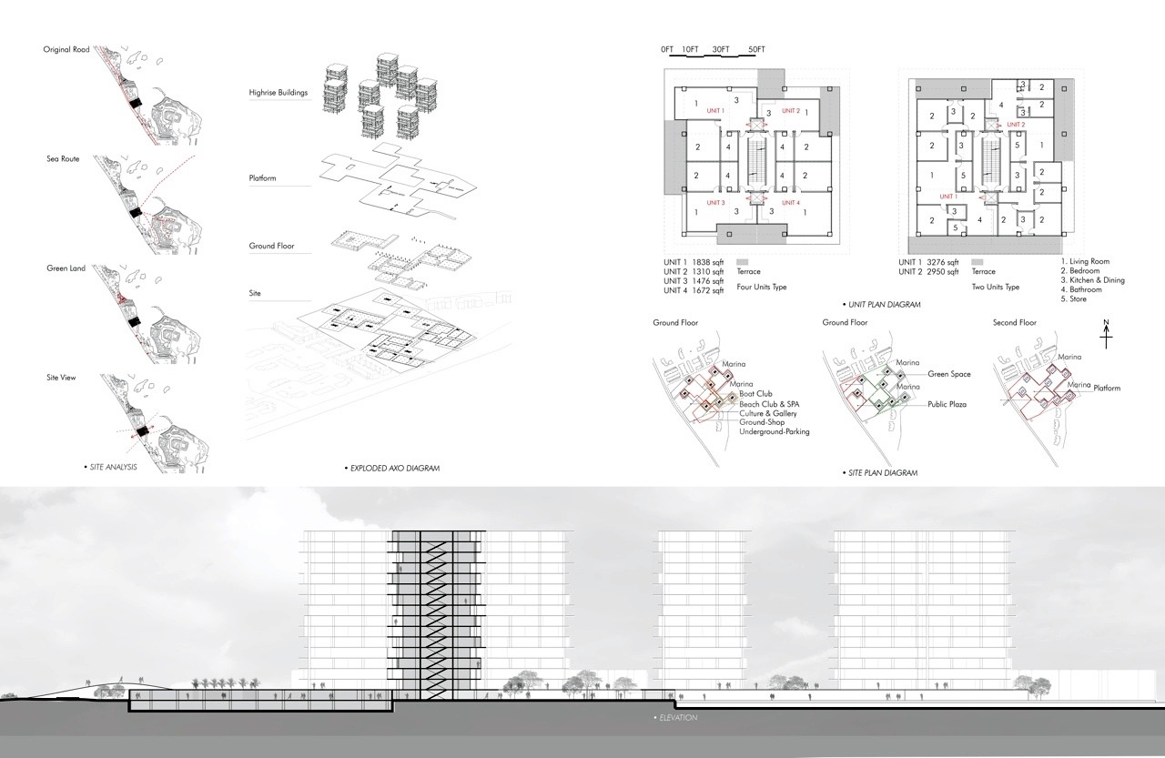

Slide 61
Longboat Key Hilton

Slide 62
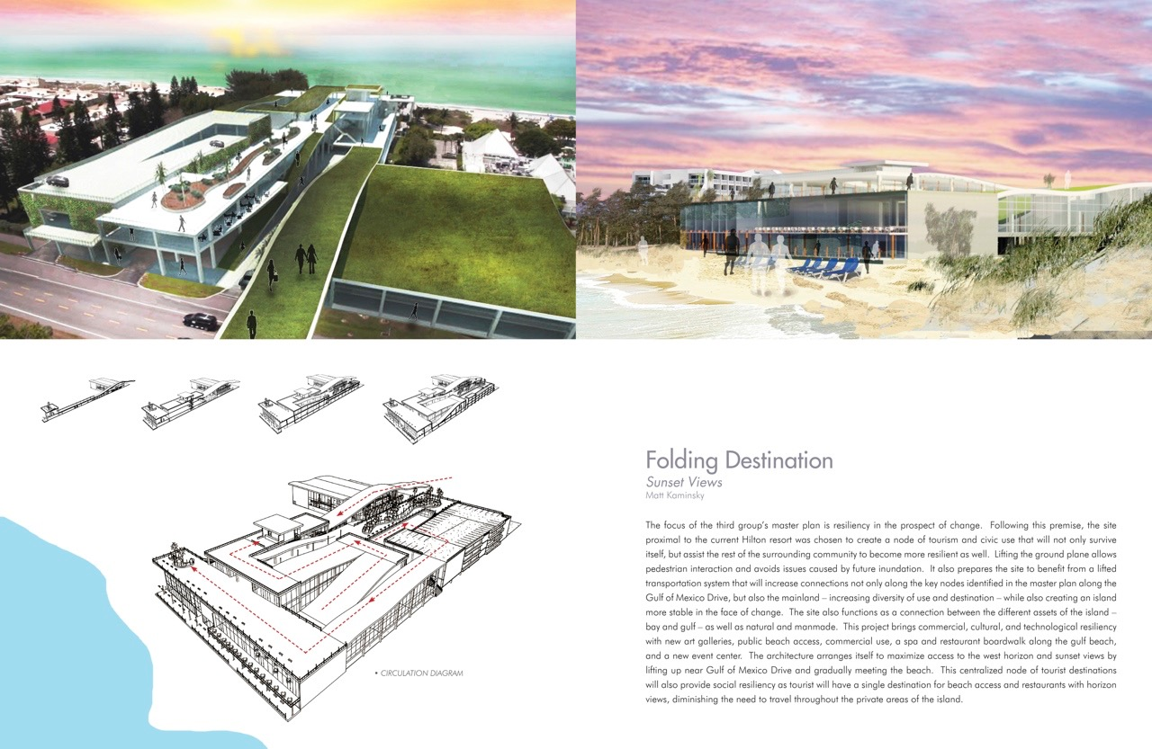

Slide 63
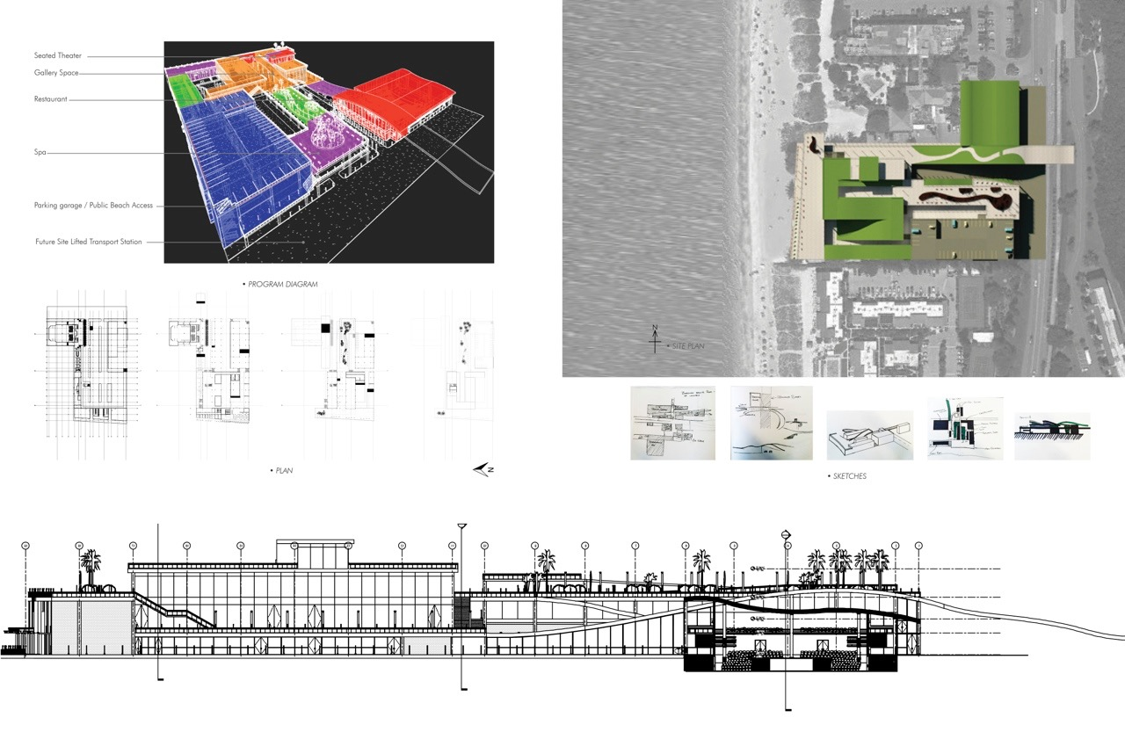

Slide 64
Bayfront Park

Slide 66
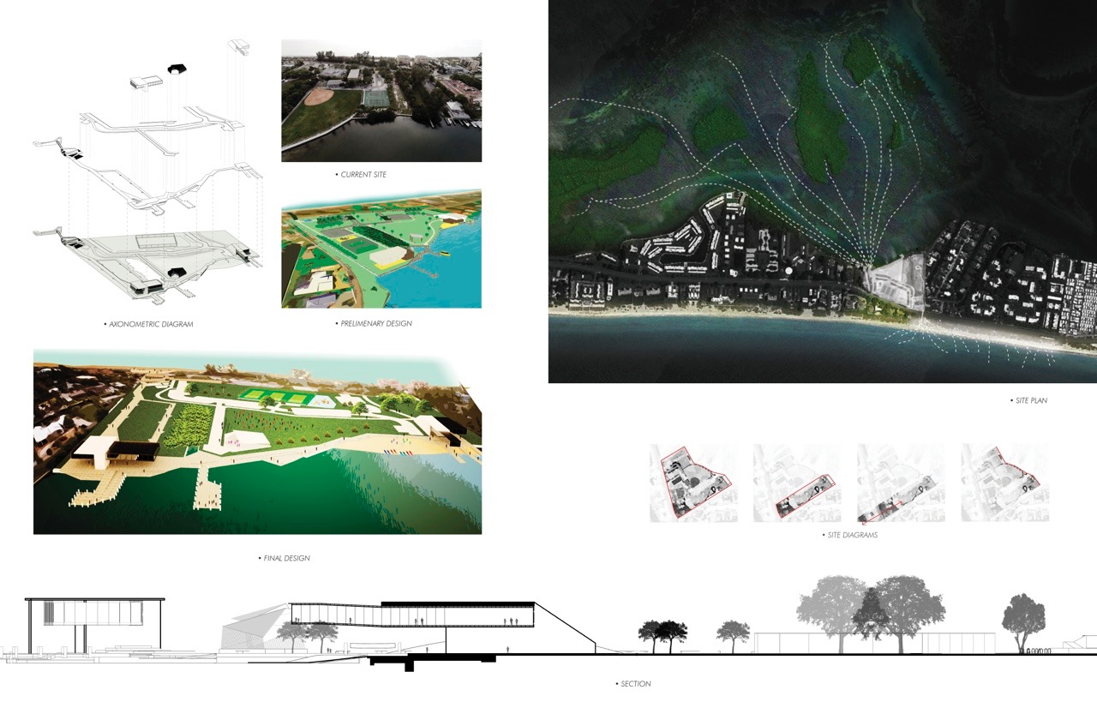

Slide 67
Downtown

Slide 68
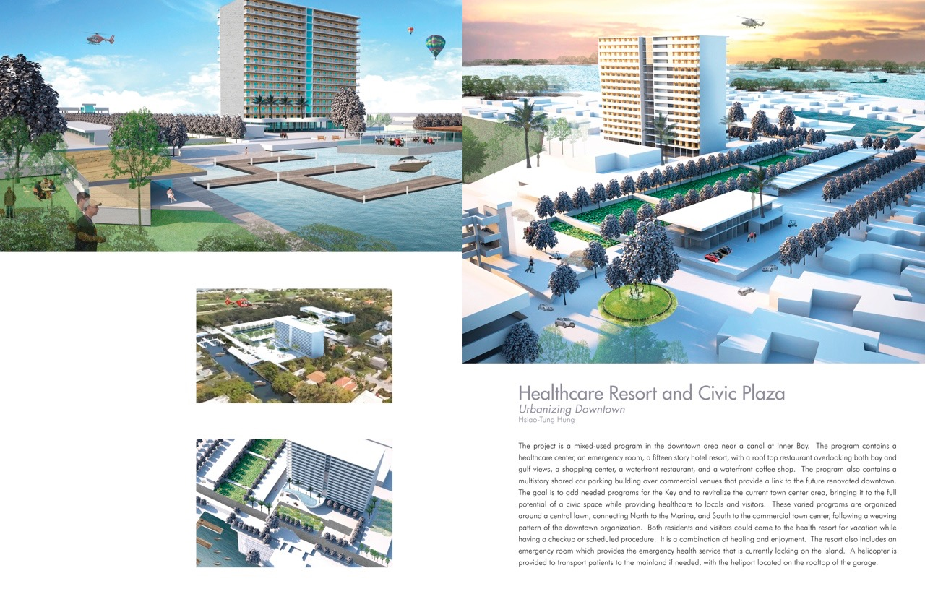

Slide 70
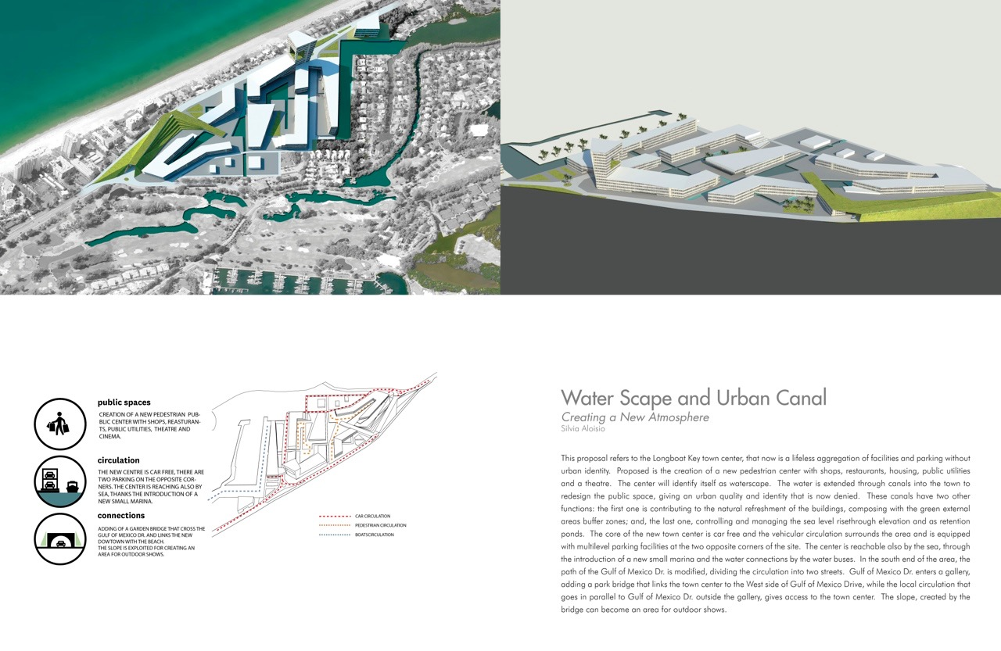

Slide 71
The Colony

Slide 72
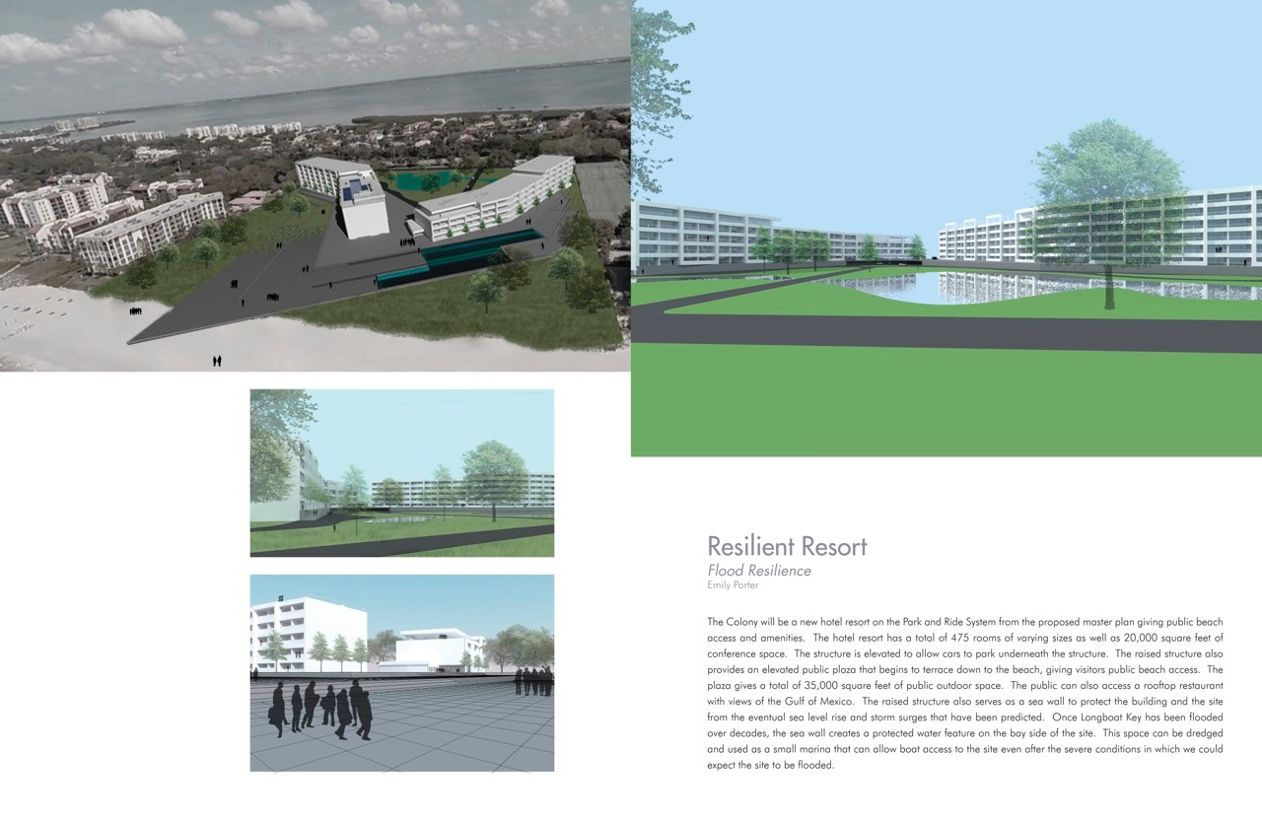

Slide 73
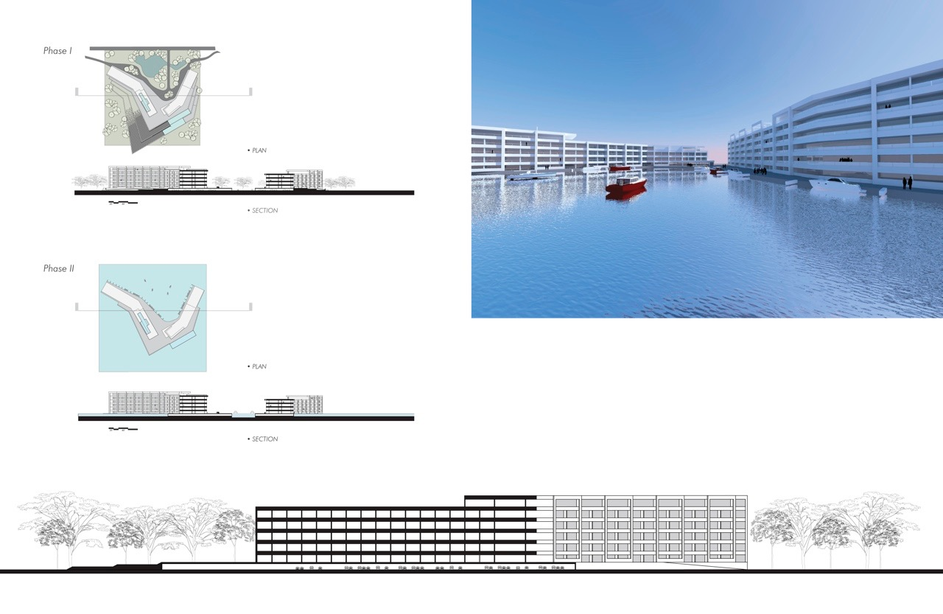

Slide 74
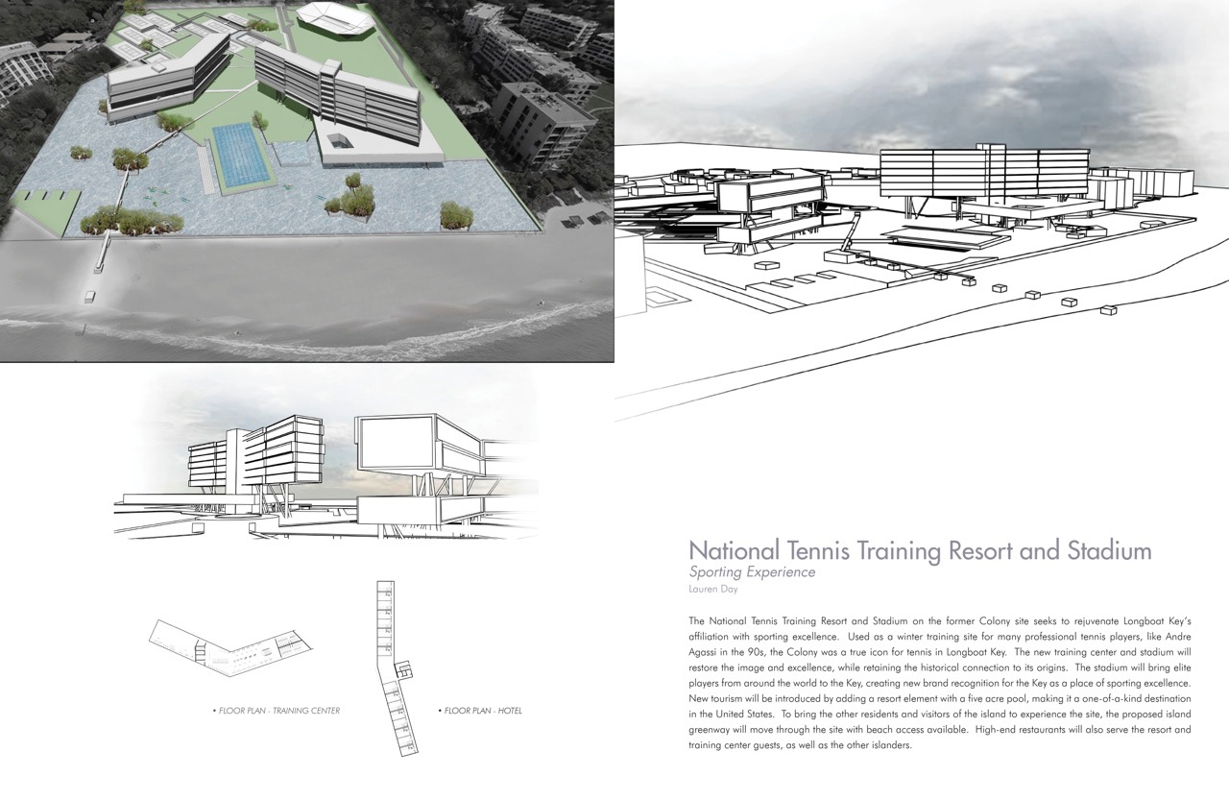

Slide 75
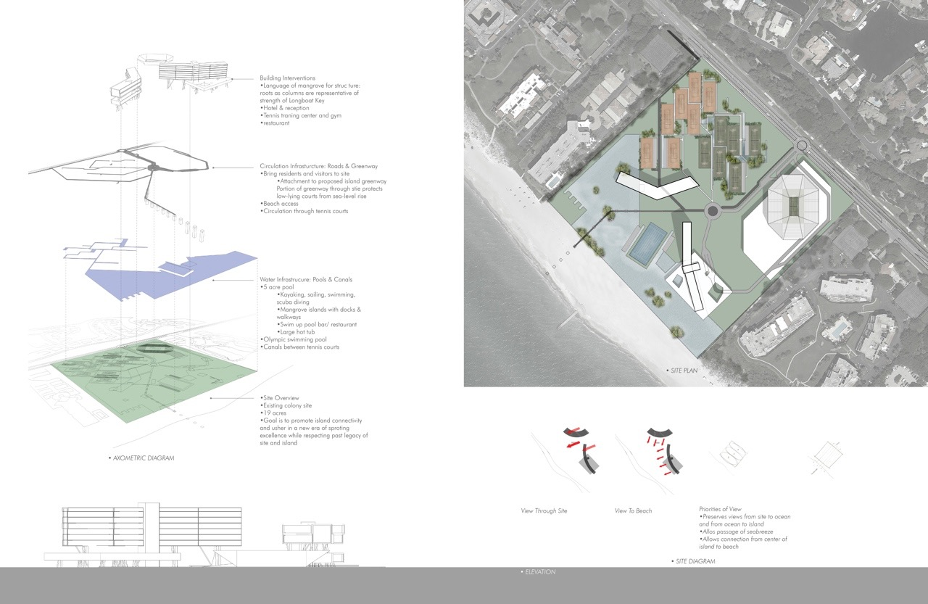

Slide 76
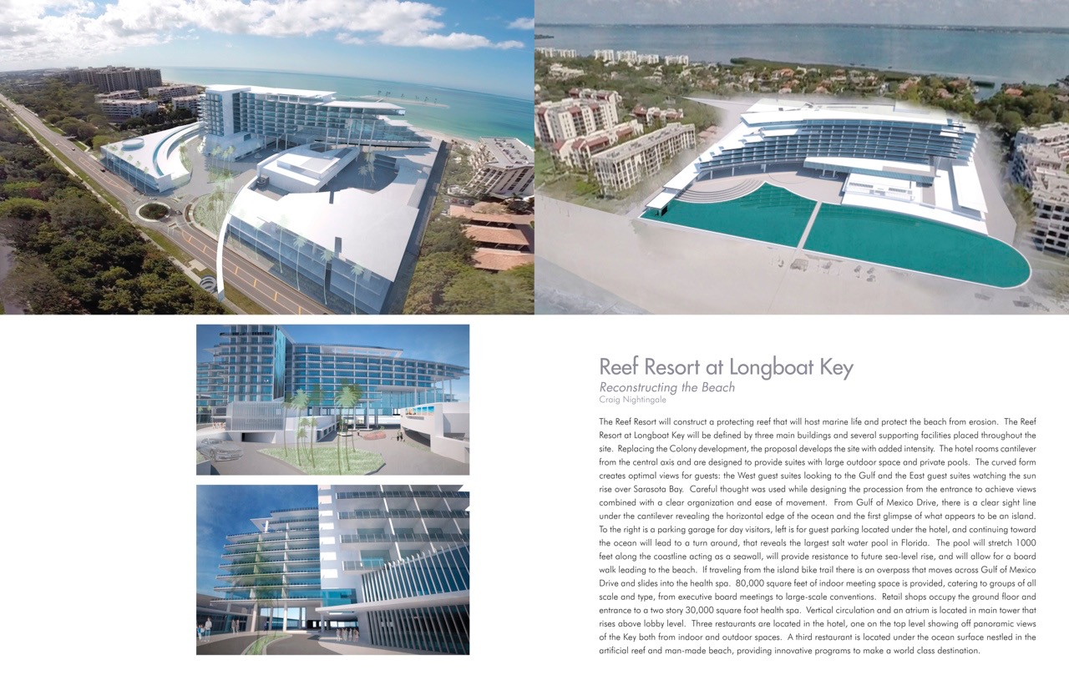

Slide 77
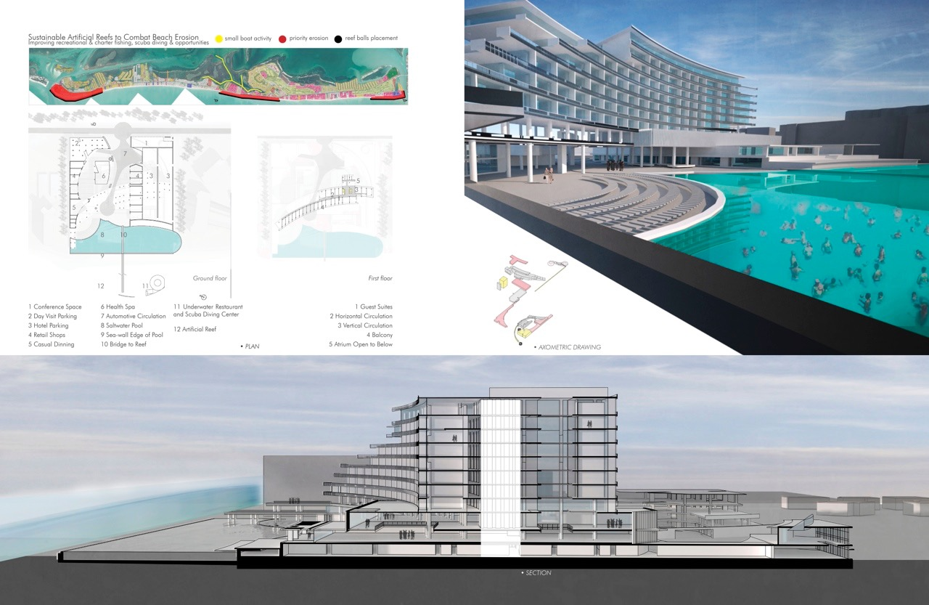

Slide 78
South Key Threshold

Slide 80
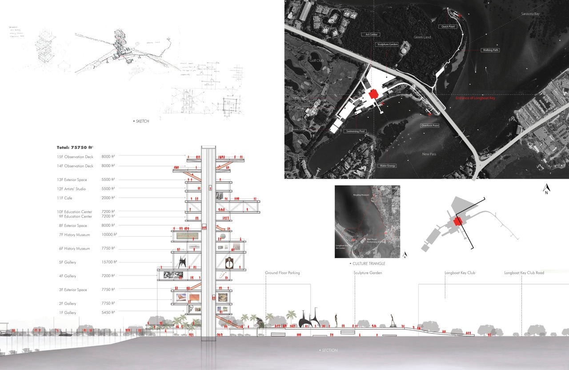

Slide 81
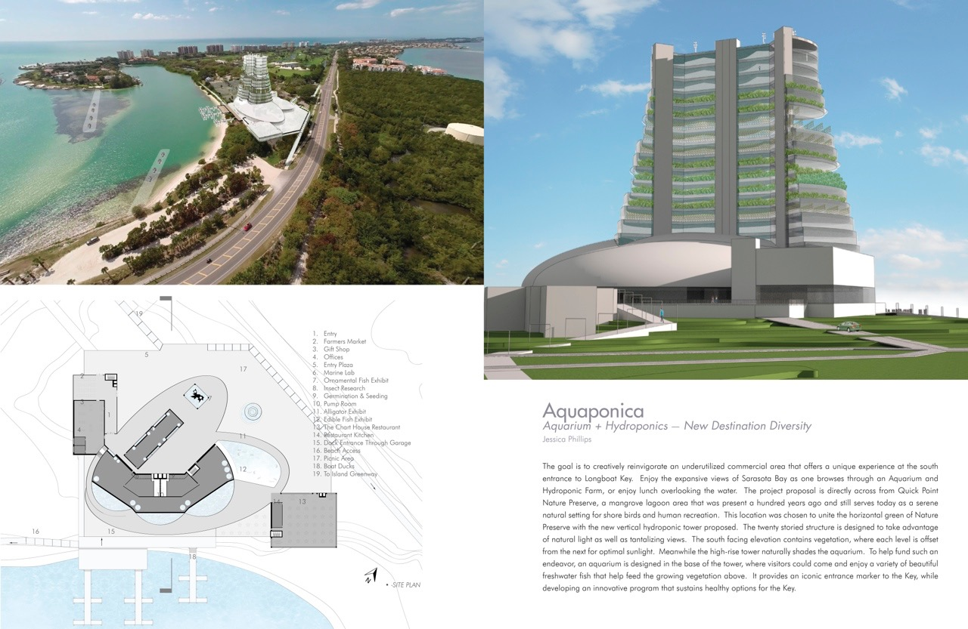

Slide 83
Recommendations Summary
1. Establish a process for bringing the varied and numerous desirable existing developments into regulatory conformance.
2. Establish growth targets and a strategic timeline for those targets for the near and long-term – 5, 10, 25, 50 and 100 years.
3. Sea level rise impacts must be evaluated on an ongoing basis and mitigation strategies should be incorporated into all land use regulations and municipal investments.
4. Conceptual analyses suggest that the current infrastructure could support approximately 5,000 more residents.
5. Substantial changes or a rewrite of the current land development regulations is needed.
Notes:
Find solutions to intractable problems.
Work with carrying capacity analyses.
Incorporate SLR options into Comp Plan and LDRs, e.g., Comprehensive Plan and Land Development Code.
Know the capacity of your existing infrastructure—depreciated for time served—and what additional capacity is necessary to sustain growth.
Legislative Implementation: e. g., Policy changes, Code changes, Direction and Prioritization of Implementation Goals, Objectives, Policies, and Strategies: GOPS.

Slide 84
Recommendations Summary
6. Longboat Key should reconnect with historic achievements and initiatives that may now be languishing or nominally forgotten such as the historic nature of Longbeach, Whitney Beach as a beach destination, the bay at Longbeach, or the potential of the Chart House area as a revitalized landmark destination.
7. Improve transportation connections with the mainland through: (1) a primarily pedestrian use bridge; and (2) a new multi-modal bridge connecting to south Bradenton.
8. Incentivize a water taxi service between the Key and mainland.
9. Consider a more permanent strategy for protecting the beach such as an artificial reef, reef seeding, or submerged rip-current diffusers.
10. Consider a municipal policy to support photovoltaic power generation and distribution on the Key.
Notes:
Identify and capitalize upon areas of opportunity.
Promote multi-modal transportation.
Incentivize water-based “public” transit.
Investigate alternatives to traditional beach renourishment—contemplate retreat.
Consider alternative energy sources for the future.

Slide 86
Singapore: Bishan Park

Slide 87
Bishan Park – aerial view

Slide 88
Stormwater Control: Concrete and Engineering

Slide 89
Stormwater Control: Design with Nature

Slide 90
COMPARISONS
BEFORE:
AFTER:

Slide 91
Kolam Retensi Kacang Pedang: Today

Slide 92
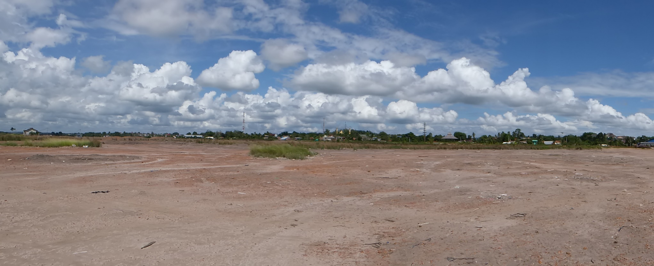
Kolam Retensi Kacang Pedang: Today

Slide 93
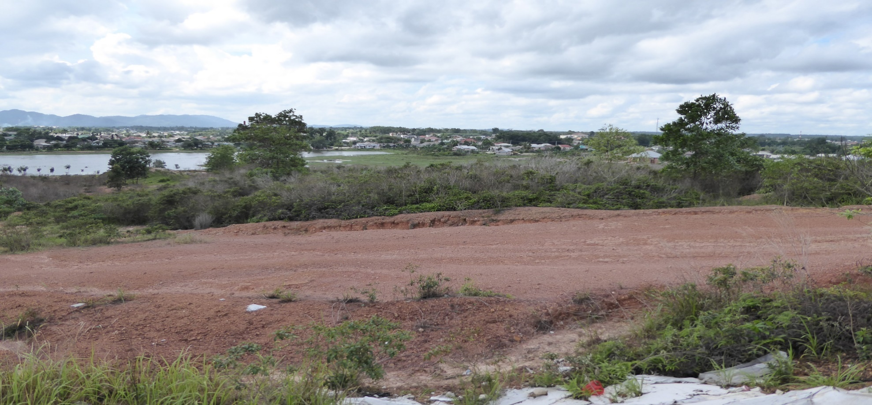
Kolam Retensi Kacang Pedang: Today

Slide 94
Kolam Retensi Kacang Pedang: Today

Slide 95
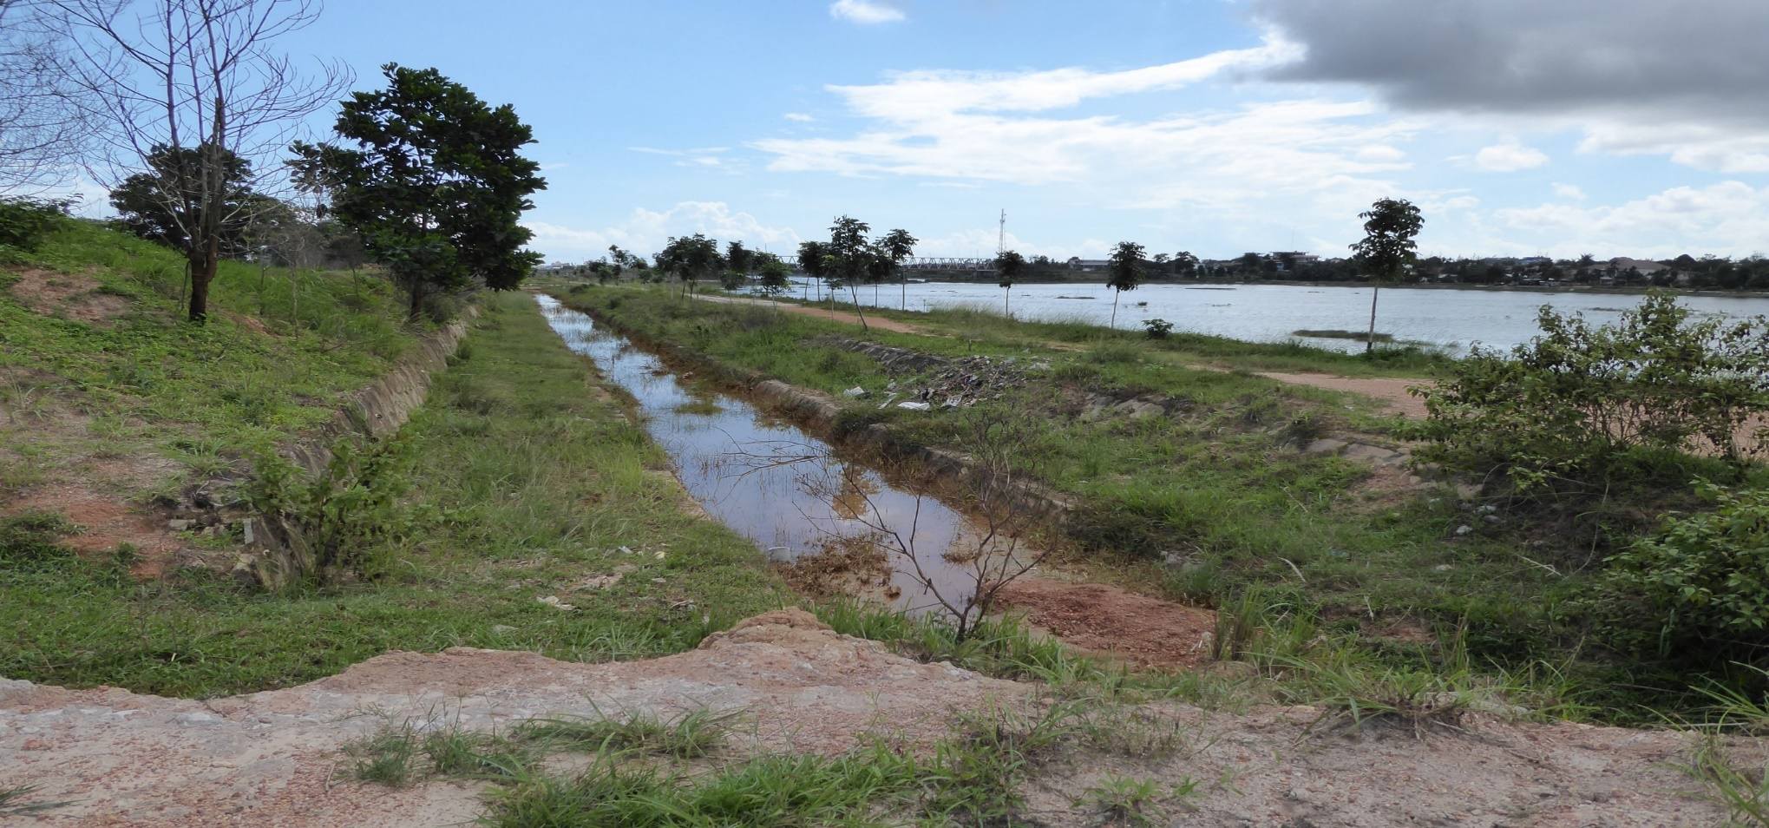
Kolam Retensi Kacang Pedang: Today

Slide 96
Kolam Retensi Kacang Pedang: Yesterday (9 February 16)

Slide 97
Kolam Retensi Kacang Pedang: Yesterday (9 February 16)

Slide 98
Kolam Retensi Kacang Pedang: Yesterday (9 February 16)

Slide 99
Kota Tua Pangkalpinang: Yesterday (9 February 16)

Slide 100
Kolam Retensi Kacang Pedang: Yesterday (9 February 16)

Slide 101
Kota Tua Pangkalpinang : Yesterday (9 February 16)

Slide 102
Kota Tua Pangkalpinang : Yesterday (9 February 16)

Slide 103
Kota Tua Pangkalpinang : Yesterday (9 February 16)

Slide 104
Bishan Park: Before Stormwater Control = Concrete and Engineering

Slide 105
Bishan Park: After Stormwater Control = Design with Nature

Slide 106
Kota Pangkalpinang: Today

Slide 107
Kota Pangkalpinang: Tomorrow
?

Slide 108
Kemenangan Pertamanan (Victory Park): (Kolam Retensi Kacang Pedang)

Slide 109
Kemenangan Pertamanan (Victory Park): (Kolam Retensi Kacang Pedang)

Slide 110
Kemenangan Pertamanan (Victory Park): (Kolam Retensi Kacang Pedang)

Slide 111
Resilient Communities
Collaborative efforts related to creating and sustaining local communities and regions faced with various threats, including natural hazards and resource constraints, as well as market hazards resulting from public and private actions.
Notes:
Collaborative efforts to create and sustain local communities and regions faced with threats, including natural hazards, resource constraints, and market hazards resulting from public and private actions.
A collaborative of effort related to creating and sustaining local communities and regions faced with various threats, including natural hazards and resource constraints, as well as market hazards resulting from public and private actions.

Slide 112
Kemenangan Pertamanan (Victory Park): (Kolam Retensi Kacang Pedang)

Slide 113
Alun Alun : Happy Times

Slide 114
Alun Alun : Yesterday (9 February 16)

Slide 115
Kota Pangkalpinang: City of Victory

Slide 116
Kota Pangkalpinang: City of Victory

Slide 117
Kota Pangkalpinang: City of Victory
I know why you’re here: You’re here to plan for the future.
This is my City. This is my future!
Don’t mess it up!

Slide 118
A Future of Resilient Infrastructure
Notes:
Where are we, but on the same planet—EARTH—and what are we going to do about it as the pre-eminent species in the Universe? JFK?

Slide 119
Implementation Plan:
South Florida Resilient Redesign
Salt Ponds Area-wide Adaptation Action Area
Modify Comprehensive Plan (& CIP) and Land Development Code to:
Prioritize policies and CIP
Provide for Mixed Use redevelopment
Waive permit fees for plans to elevate pre-FIRM units
Provide for transfer of existing pre-FIRM units to redevelopment Receiving area(s).

Slide 120
A Future of Resilient Infrastructure
MANATEE COUNTY POST-DISASTER REDEVELOPMENT PLAN (PDRP) AUDIT AND UPDATE:
LITERATURE REVIEW
BEST MANAGEMENT PRACTICES
PLAN COMPATIBILITY
COMPREHENSIVE PLAN
COMPREHENSIVE EMERGENCY MANAGEMENT PLAN (CEMP)
LOCAL MITIGATION STRATEGY (LMS)
STATUTORY + OTHER STATE REQUIREMENTS, i.e, Adaptation Action Areas
EXISTING PDRP ANALYSIS
CONCLUSIONS AND OVERALL RECOMMENDATIONS
ALIGN THE PDRP WITH ALL OTHER COUNTY-WIDE PLANNING DOCUMENTS, and
ALIGN OVERALL APPROACH WITH NATIONAL PREPAREDNESS

Slide 121
UNIVERSITY OF FLORIDA RESILIENT COMMUNITIES INITIATIVE (UFRCI)
Website: http://frci.dcp.ufl.edu/
Notes:
I’m the Research + Development Manager for the University of Florida’s Resilient Communities Initiative.
Here’s a screen shot of the home page of our website and the address.

